Slide 1
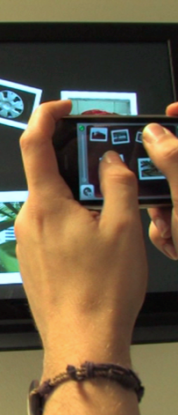
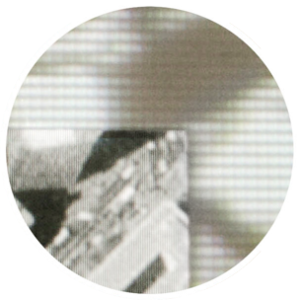
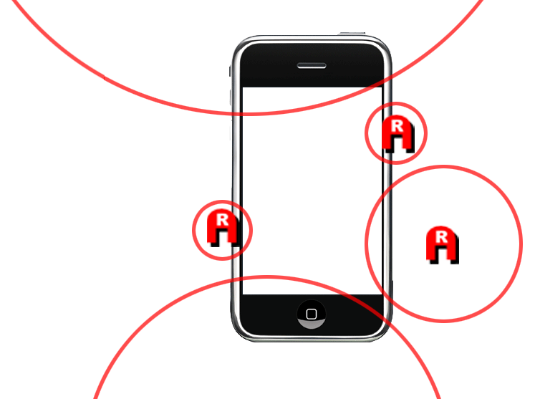
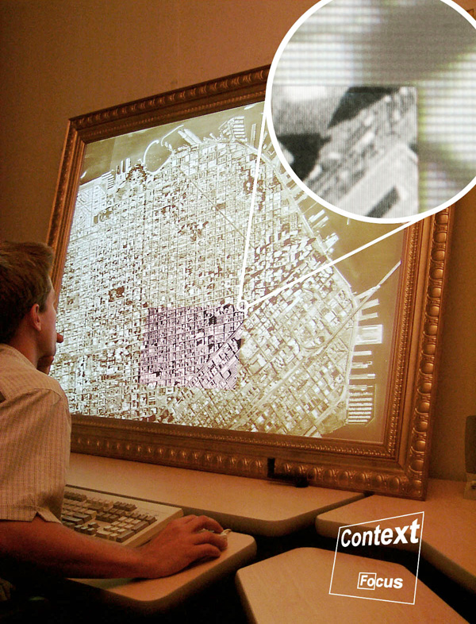
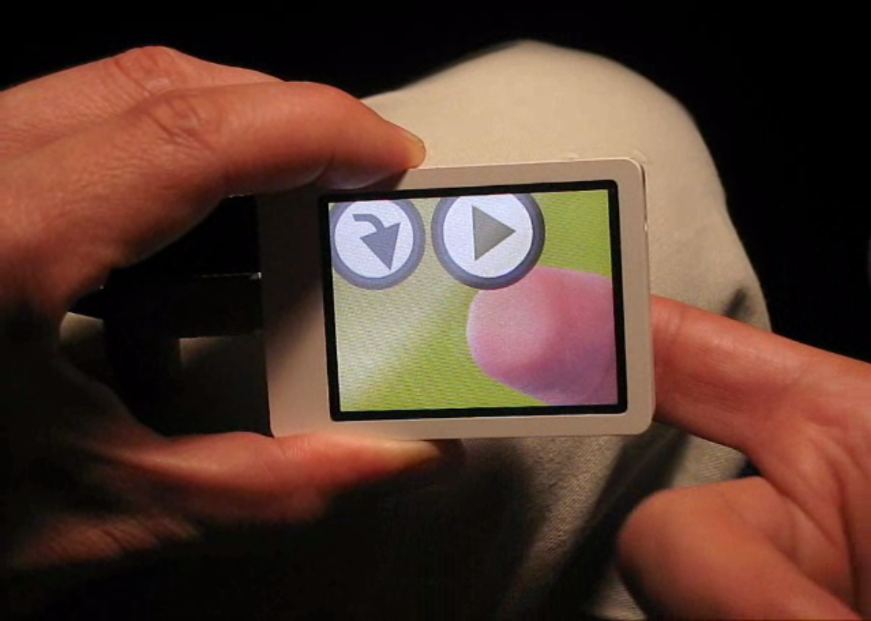
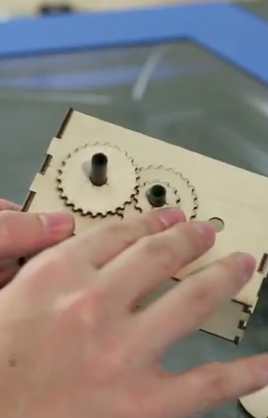
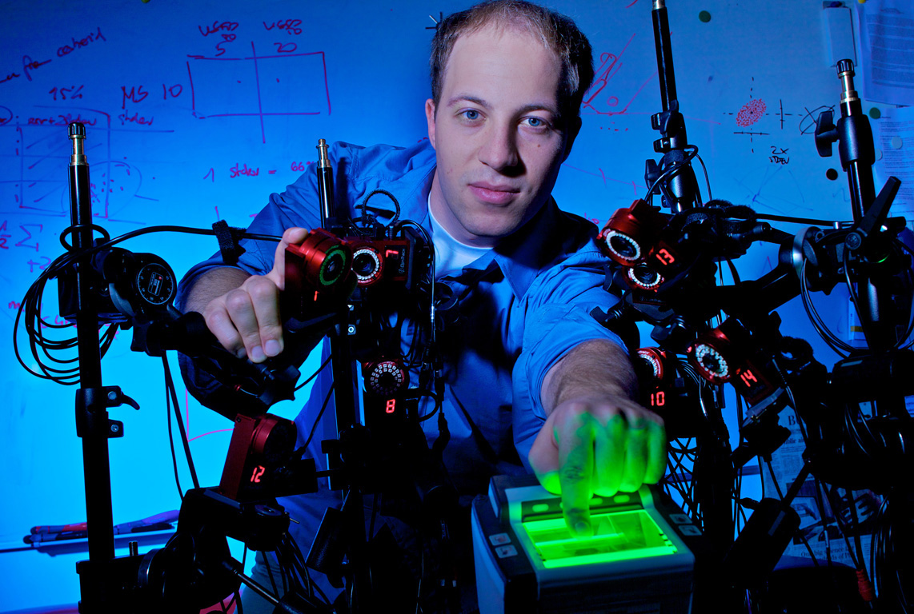
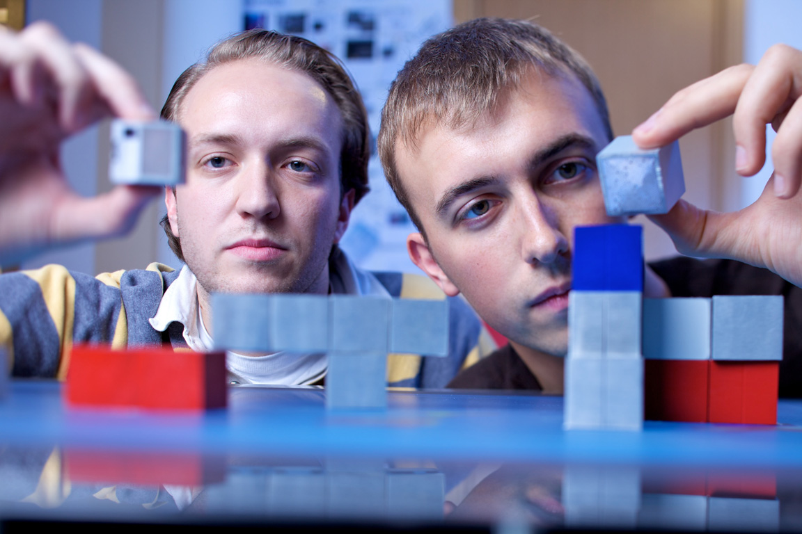
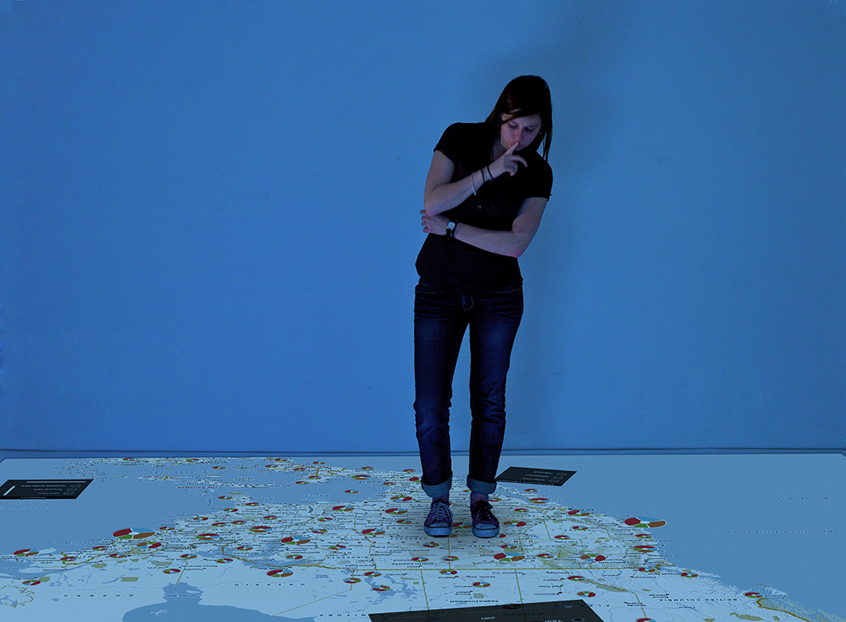
NAVIGATION
PART 1:
scaling NUI systems to
large contents, detail, precision
PART 2:
“function follows form”
from touch screens to smart rooms
CLOSURE: future

Slide 3

natural
patrick baudisch
keynote British HCI 2012

Slide 4

if you had to build an interactive system
for 1-year olds
what would be your design objectives?

Slide 5
summary:
natural := a single unified interaction space

Slide 6
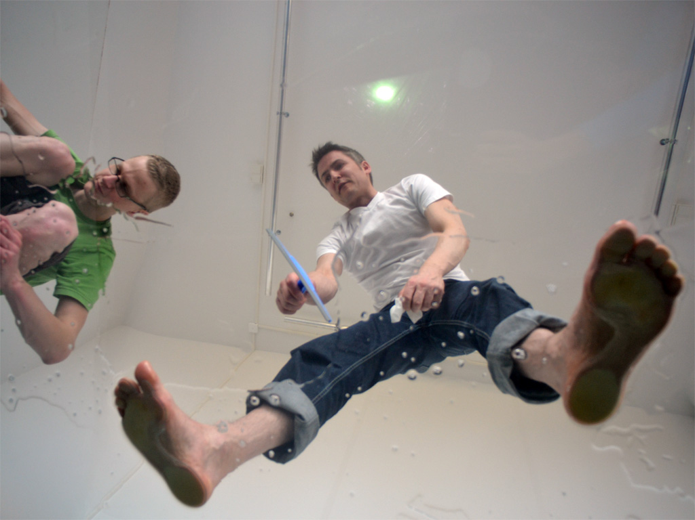
and, well, there will be feet

Slide 7
towards NUI

Slide 8
traditional interaction with computers was (and is) asymmetric…

Slide 9
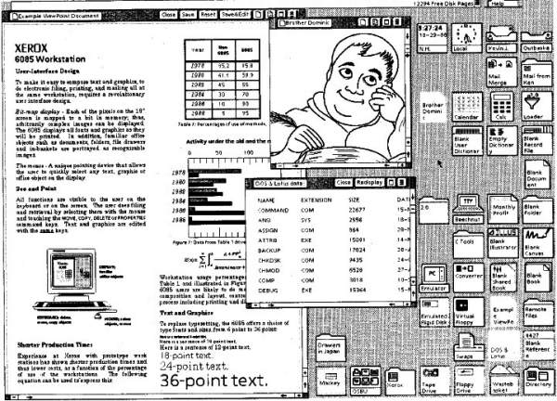
users perceive computers in visual detail..

Slide 10
…in contrast, computer perceive users as
user := a moving crosshair
(122,405)

Slide 11
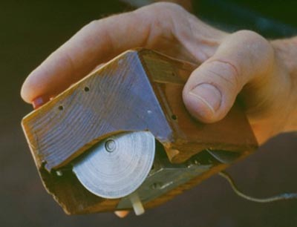
we are still living in 1968
Notes:
http://sloan.stanford.edu/MouseSite/MouseSitePg1.html

Slide 12
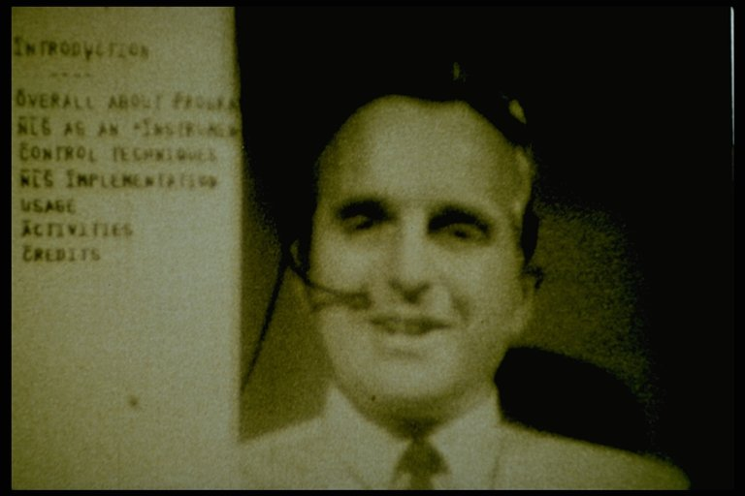
we are still living in 1968
Notes:
http://sloan.stanford.edu/MouseSite/MouseSitePg1.html
A real paradigm shift here (to use an overused term)

Slide 13
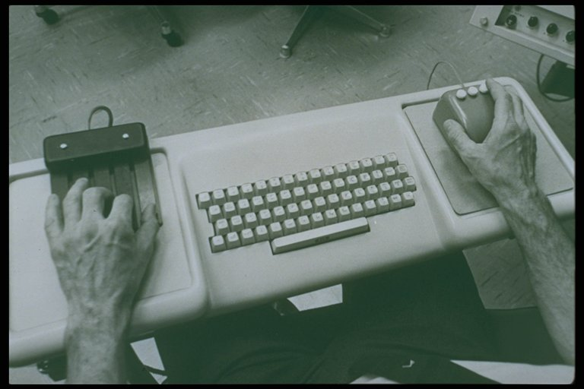
we are still living in 1968

Slide 14
but the world is changing…

Slide 15
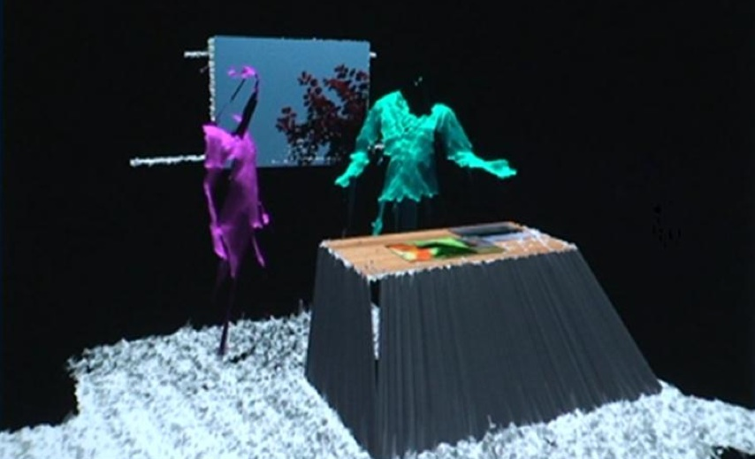
"NUI"
computers start seeing (& hearing) us the same way we see them: using cameras
[image: benko wilson]

Slide 16
influences do not come from the office anymore,
but from…

Slide 17
film, animation,
& games

Slide 18
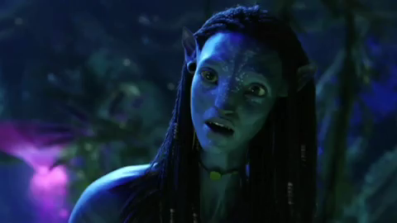

Slide 19
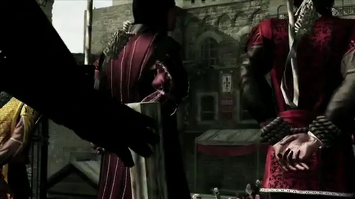

Slide 20
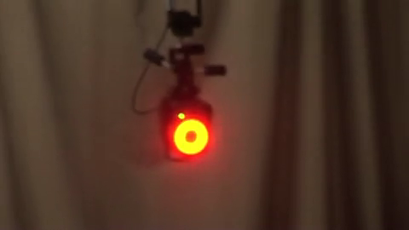

Slide 21
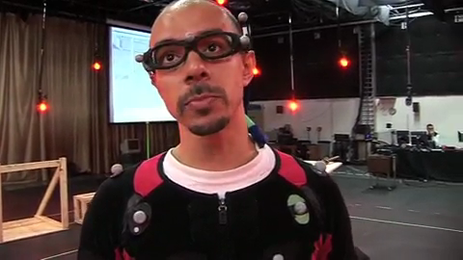
this is a > $1.000.000 installation

Slide 22
mass-availability

Slide 23
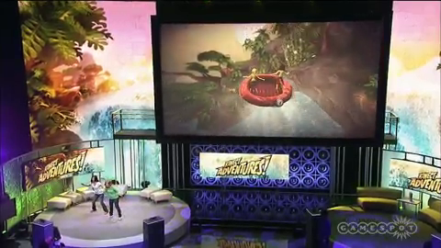
providing masses with 3D mocap…

Slide 24
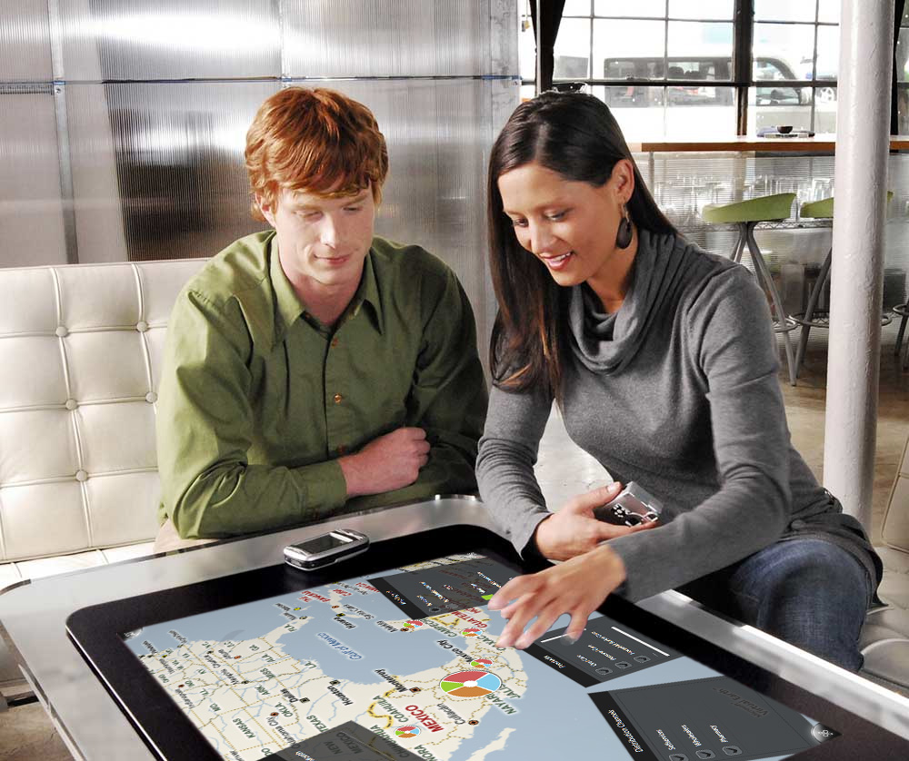
..and rich 2D input

Slide 25
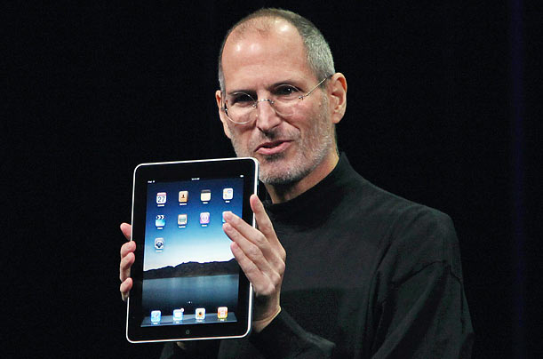
..and rich 2D input

Slide 26
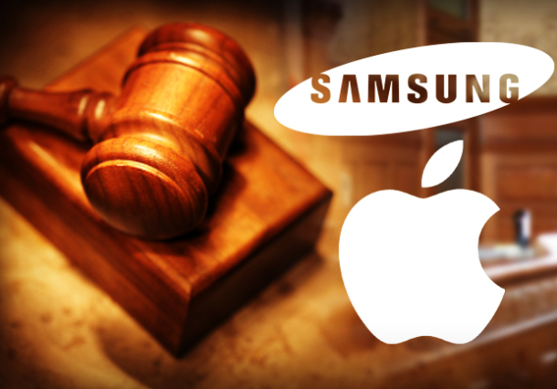
huge implications: devices ⬅➔ HCI

Slide 27
but…

Slide 28
what is ‘natural’ about these devices?

Slide 29
or, even more basic…

Slide 30
what is ‘natural’?

Slide 31
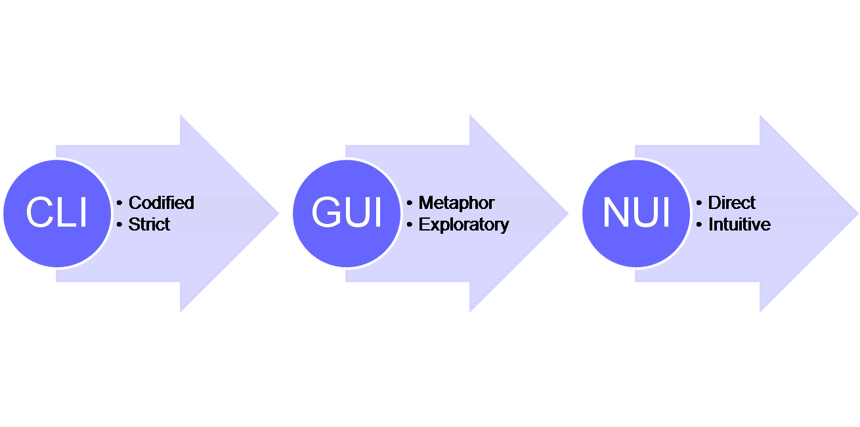
Steve Mann:
"metaphor-free computing"
[wikipedia]

Slide 32

#1: CLI = immediate visual feedback

Slide 33
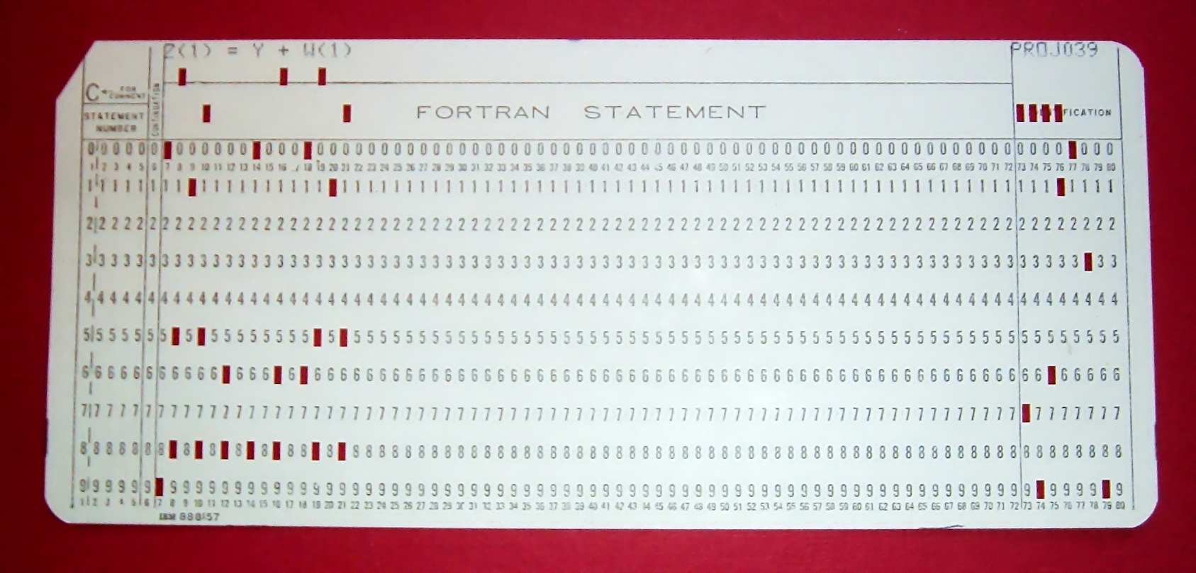
(
)
keep in mind how "HCI" started out

Slide 34
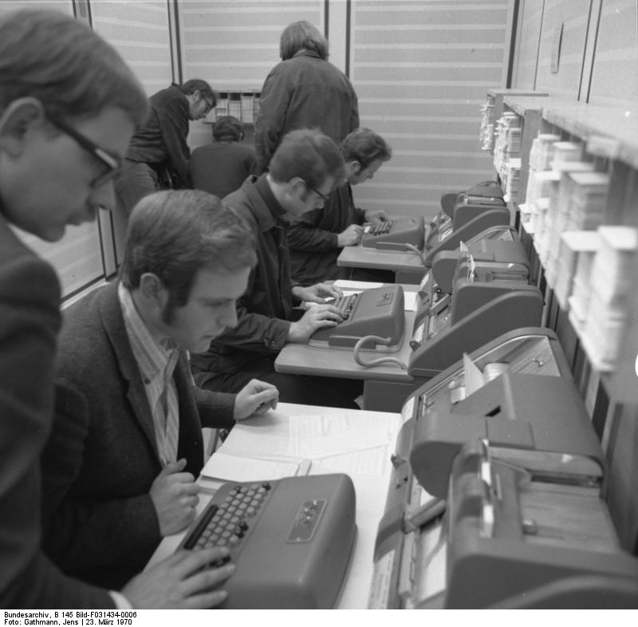
(
)
keep in mind how "HCI" started out
[bundesarchiv]

Slide 35
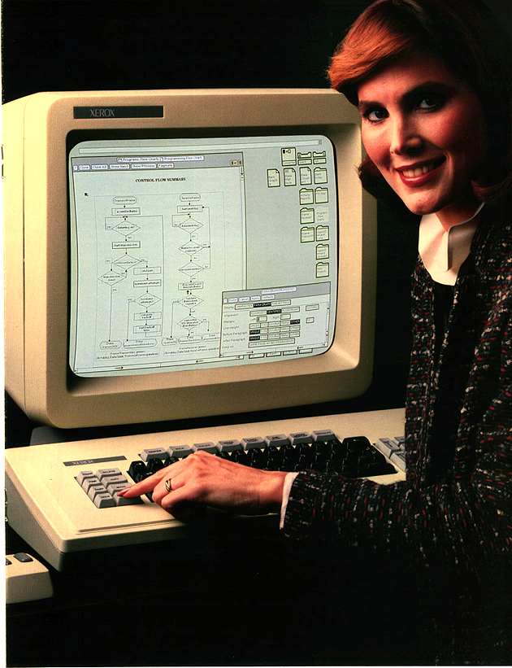
#2: GUI = the office

Slide 36
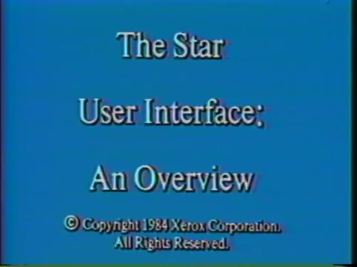

Slide 37
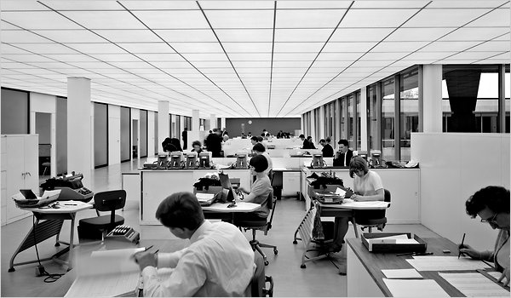
in the 70s, it seemed fair to assume
that users had worked in an office

Slide 38
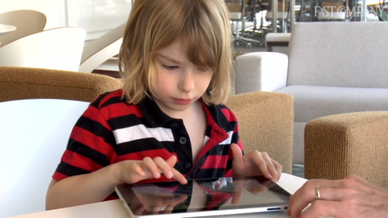
2012: the office assumption has long failed

Slide 39
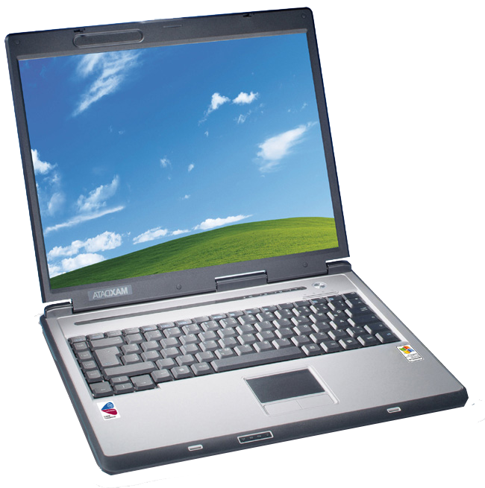
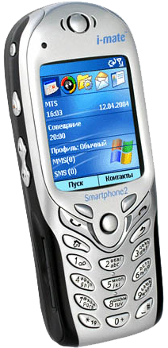
800 million PCs
5 billion
mobile devices

Slide 40
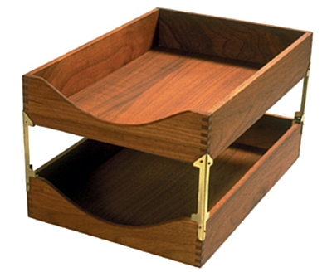

new users may wonder…

Slide 41
skeuomorph ::
is a derivative object that retains ornamental design cues to a structure that was necessary in the original.

Slide 42
so what can we rely on her knowing?

Slide 43
the physical world around

Slide 44
touching, pointing, distances
inertia, spatial memory, ballistics
= very few rules & highly consistent

Slide 45
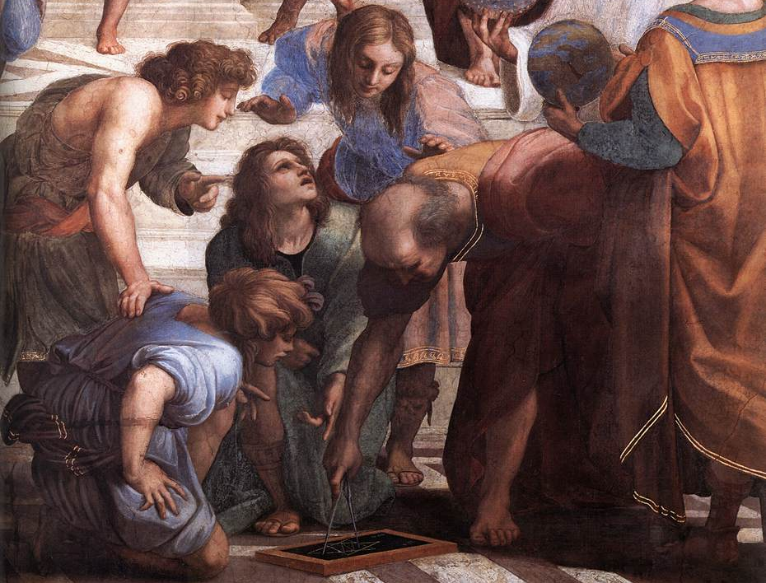
euclid
distances, angles, translation, rotation

Slide 46

newton
1. objects stay at rest / in motion
2. objects accelerate when you apply force
3. you can bump stuff…

Slide 47
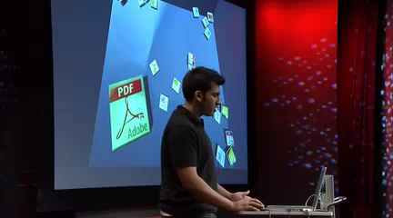
[bumpTop, anand agrawala]

Slide 48
let me try to wrap this up in (my personal) definition…

Slide 49
#1 NUI
an interface that a "1-year-old" can operate

Slide 50
and if a 1-year olds only
understands Euclid and Newton…

Slide 51
#2 NUI
an interface that a user can operate
who only knows Euclid and Newton

Slide 52
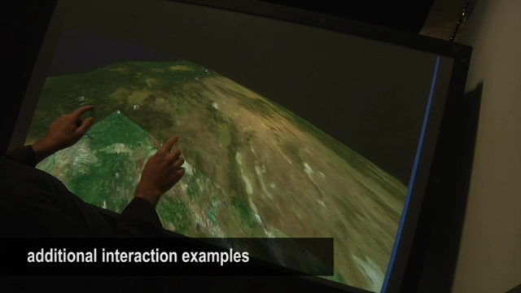
what we can do by pointing & dragging
[Reisman 2009]

Slide 53
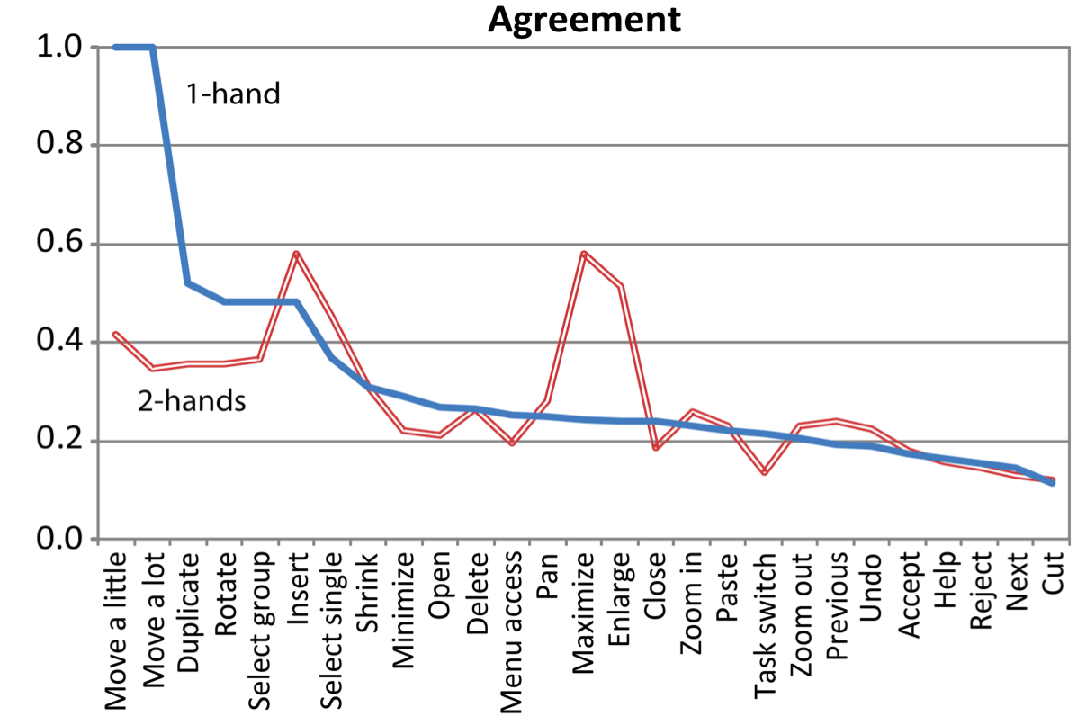
the notion that any gesture-based UI is intuitive is apparently a myth
these "Euclidean gestures" are natural
[Wobbrock, Morris, Wilson, 2009]

Slide 54
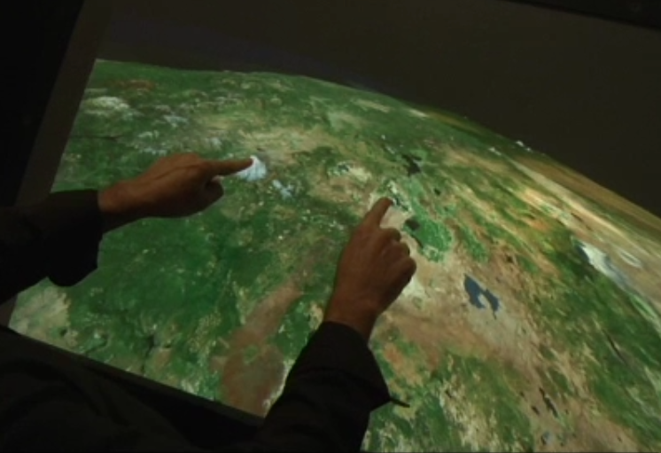
screen connects virtual with physical

Slide 55
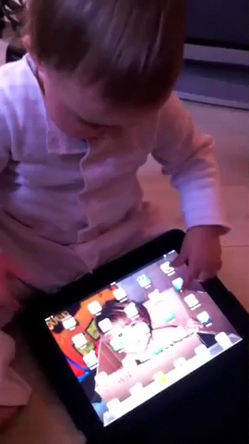

Slide 56
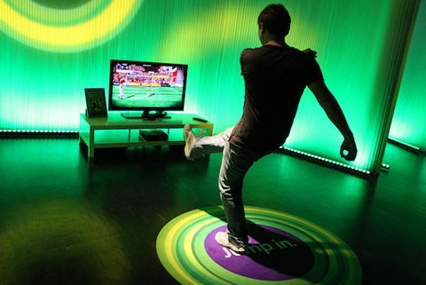
!=
spatial
spatial
in contrast: how to kick this ball?

Slide 57
insight
spatial + spatial != spatial

Slide 58
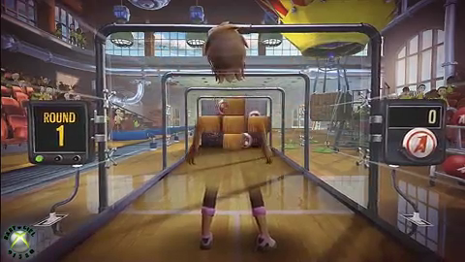
avatars may bridge gap (metaphor again)

Slide 59
natural := user and objects form one space

Slide 60
#3 NUI
(ideally) a single Euclidean/Newtonien space that includes display(s) and user

Slide 61
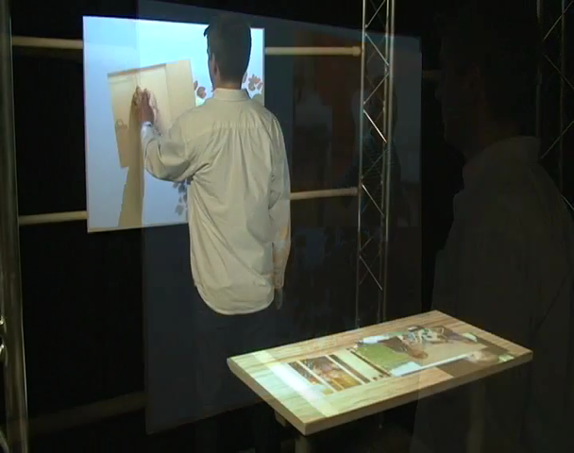
also in 3D [lightspace, benko wilson 2010]

Slide 62

oddly, this setup does not

Slide 63
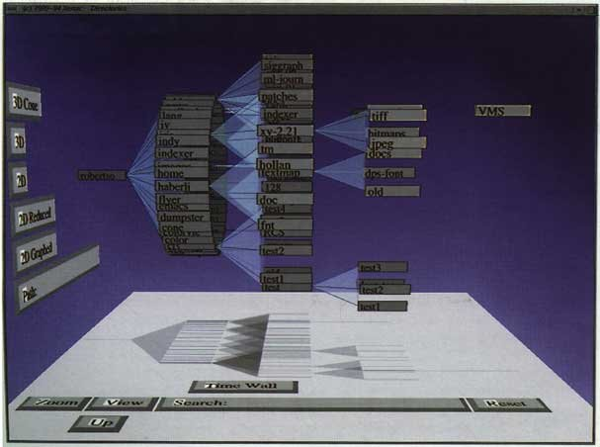
myth #2: UI has to be 3D to allow leveraging users' real-world experience

Slide 64
2D is equally or more intuitive

Slide 65
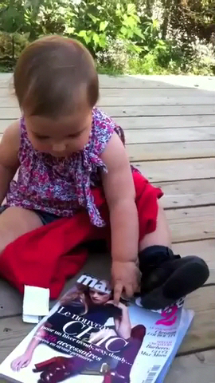

Slide 66
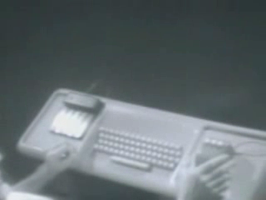
…mouse does not (1) angles (2) screen

Slide 67
this talk
how to create devices that allow NUI interactions, i.e., Euclidean/Newtonian

Slide 68
PART 1:
scaling NUI systems to
large contents, detail, precision
PART 2:
“function follows form”
from touch screens to smart rooms
CLOSURE: future

Slide 69
scaling NUI
PART 1

Slide 70
today: space & precision limited by device

Slide 71
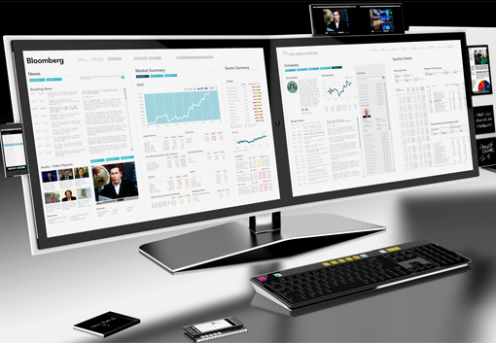
challenge
scale NUI to large docs, detail, precision

Slide 72
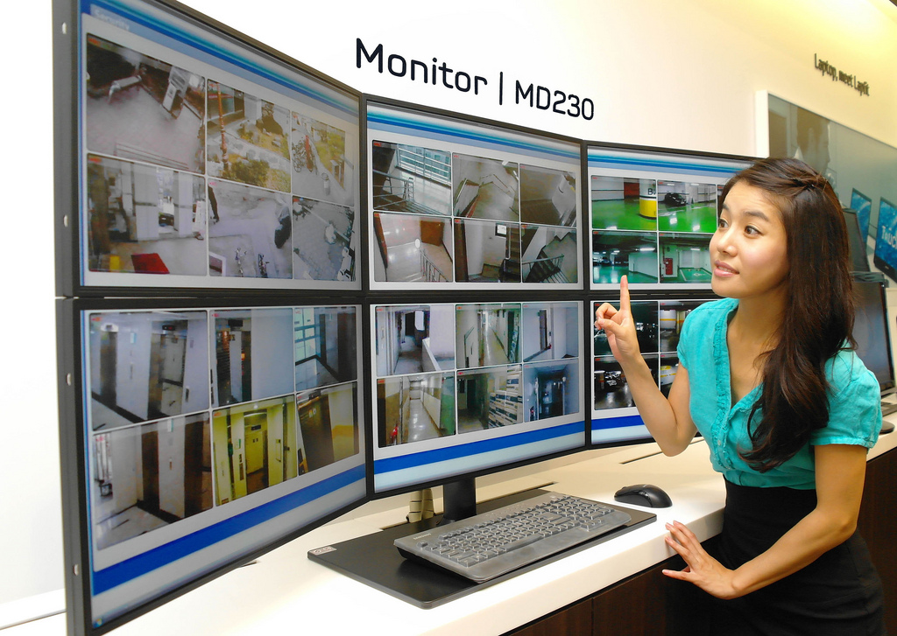
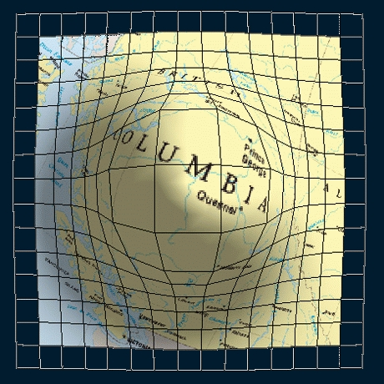
classic HCI techniques provide space and precision, but make non-NUI

Slide 73
creating NUI versions of these

Slide 74
#1
NUI version of multi-display environments

Slide 75
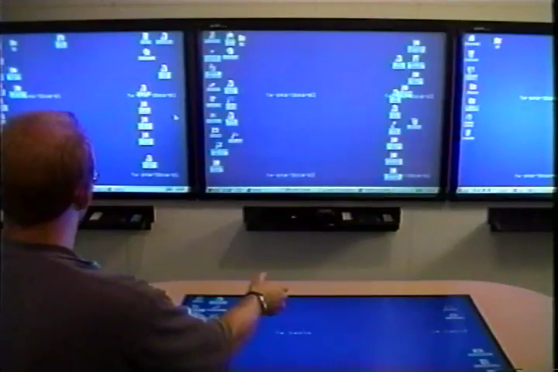
integration mouse [PointRight Johanson'02]

Slide 76
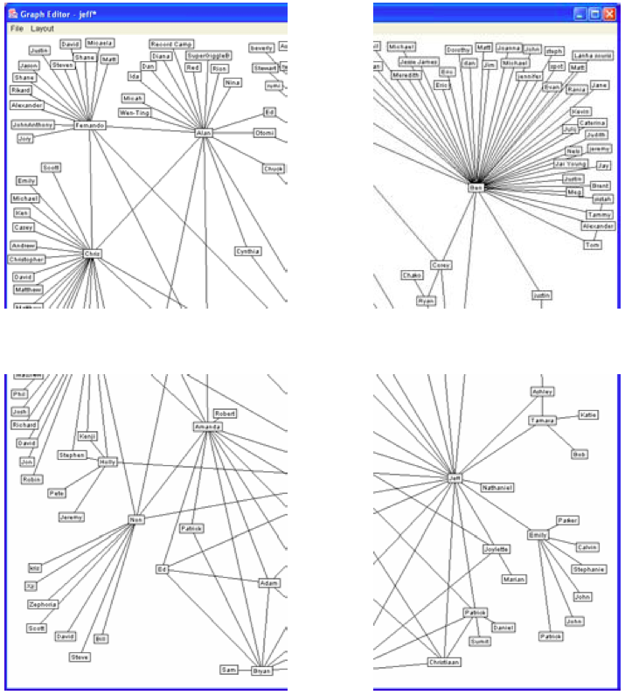

?
display across [Mackinlay, 2003]

Slide 77
start
target

Slide 78
calibration [mouse ether 2003]

Slide 79

calibration [mouse ether 2003]

Slide 80
calibration
step 1
step 3
step 2

Slide 81
with mouse ether
start
target

Slide 82

direct input [stitching 2004]

Slide 83

one pen stroke → natural Euclidian space

Slide 84
and for non-planar screen arrangements…

Slide 85

integration [Hyperdragging, Rekimoto '99]

Slide 86

perspective [Perspective Cursor, Nacenta]

Slide 87

perspective [Persp. Cursor, Nacenta '06]

Slide 88

using direct input [touch projector 2010]

Slide 89

single, natural Euclidian 3D space

Slide 90

(
panaromic viewfinder [2005]…

Slide 91

)
…product "photosynth" [2010]

Slide 92
#2
providing context the NUI way

Slide 93

fisheyes provide context…

Slide 94

but also distort distances [mcguffin]

Slide 95
in software [halo 2003]

Slide 96



+

Slide 98
R
R
R
demo

Slide 99

R
R
R

Slide 100

no distortion, natural Euclidean space

Slide 101

peek a boo

Slide 102
in hardware [focus+context screens 01]

Slide 103


Slide 104



Slide 105







Slide 107


Slide 108


Slide 109


Slide 110

single, natural Euclidean space

Slide 111


direct input [Escritoire, Ashdown ‘03]

Slide 112

directly moveable focus [Holmquist, 2005]

Slide 113

#3
NUI version of precise pointing techniques

Slide 114
fat finger problem [2007]

Slide 115
stylus
offset cursor
distort input space [offset cursor, potter '88]

Slide 116
let users point at the target [shift 2007]

Slide 117

new approach: lucidTouch [2007]

Slide 118


Slide 119


Slide 120


Slide 121
<formula>
front = screen
sides = buttons
back = touch

Slide 122
watch

Slide 123
pendant

Slide 124
clip-on

Slide 125
ring

Slide 126

video
single, natural Euclidean space

Slide 127
challenge
getting large contents, precision, & NUI…

Slide 128
tricky, but possible with custom hardware

Slide 129
PART 1:
scaling NUI systems to
large contents, detail, precision
PART 2:
“function follows form”
from touch screens to smart rooms
CLOSURE: future

Slide 130
scaling NUI hardware down
PART 2

Slide 131

goal
where is 3D sensing technology going
(and what will we be able to do with it?)

Slide 132

let’s look at how 2D sensing evolved

Slide 133
multitouch sensing

Slide 134
1980s: CRT
1990s: projection
2000s: LCD
2010s: OLED…
touch was driven by display evolution

Slide 135
(and I will argue later
that 3D input will follow a similar pattern)

Slide 136
by 1987s all main sensing technologies were known
(but all were on CRTs still)
1980s: CRT

Slide 137

single touch capacitive [Johnson' 65]

Slide 138

…and (multi) light pen [Whirlwind, 1952]

Slide 139


Han [2006] FTIR [Kasday 1981]

Slide 140
pretty advanced already, the 80s…

Slide 141
1980s: CRT
1990s: projection
90s: digital/LCD projection mass-available
(invented by Gene Dolgoff, 1984)

Slide 142


touchpad→screen [Mehta '82, Rekimoto'97]

Slide 143

front projection [diamondtouch, 2001]

Slide 144
1980s: CRT
1990s: projection
2000s: LCD
2000: good flat screens, such as LCDs…

Slide 145


IBM Simon 1994
Palm Pilot 1997
iPhone 2007
capacitive
…allowed for mobile use (with resistive)

Slide 146
capacitive → natural gestures on mobile
[Wobbrock, Morris, Wilson, 2009]

Slide 147

mobile allowed for (kinda) ergonomic use

Slide 148

NUI goes mainstream

Slide 149
1980s: CRT
1990s: projection
2000s: LCD
2010s: OLED…
compliant

Slide 150

OLED/ePaper [paper phone, Vertegaal '11]

Slide 151

unmousepad [Rosenberg & Perlin 2009]

Slide 152

smart clothing

Slide 153

integration into fabric [pinstripe, karrer '11]

Slide 154




flexible [time domain reflectometry, 2011]

Slide 155

TDR messgeraet

Slide 156


Slide 157
?
what is next in touch interaction

Slide 158

screenless [imaginary interfaces, 2010]

Slide 159


Slide 160

sean gustafson (2013)

Slide 161
so for 2D sensing, form factor played a huge role.
what can we learn about sensing 3D?

Slide 162
3D from 2D
PART 3

Slide 163
1980s: CRT
1990s: projection
2000s: LCD
2010s: OLED…
flat screens allowed for touch breakthrough

Slide 164
1980s: CRT
1990s: projection
2000s: LCD
for 3D sensing we are still savely here

Slide 165

cameras…

Slide 166
…and more cameras

Slide 167

limited space [backspace, Kratz 2012]

Slide 168

maximum space [shoeSense, Bailly 2011]

Slide 169
stationary
moveable
flat
1980s: CRT
1990s: projection
2000s: LCD
how to sense 3D using a flat form factor?

Slide 170
#1
#2
#3
ridgepad lumino multitoe

Slide 171
#1
ridgepad

Slide 172


reconstructing finger position in space

Slide 173


Slide 177
gets everything a traditional touchpad gets
but also participantID and roll, pitch, & yaw

Slide 178



Slide 179
minimum button size
15mm
10mm
5mm
2x more accurate
0mm
simulated
capacitive
fingerprint
optical

Slide 180
how to make a device though that senses and displays?

Slide 181

some day: in cell (pixel sense)

Slide 182

fiberio 2013

Slide 183


Slide 184


Slide 187


Slide 190


Slide 191
…we wanted to apply this concept to other areas.
we needed physical contact though to track…

Slide 192
#2
lumino

Slide 193
lumino

Slide 194


Slide 195

luminos = blocks with markers + seethru

Slide 196

…visible in 2D
makes 3D scene…

Slide 197


Slide 198
gravity:
almost anything that happens in 3-space manifests itself on the surface

Slide 199
#3
can we apply this to rooms…
multitoe

Slide 200


one day: roll out resistive [unmousepad'09]

Slide 201

in the meantime FTIR/rear-projection

Slide 202


Slide 203


Slide 204
head tracking got us inspired

Slide 205
can we look after inhabitants?
smart rooms based on multitouch...

Slide 206
we upgraded to 8m2 rear-projection

Slide 208
bringing the previous ideas together…

Slide 209




recognize many types of “fingerprint”

Slide 210

building blocks become furniture

Slide 211


Slide 212


Slide 213


Slide 214


Slide 215


Slide 216


Slide 217


Slide 218
flat NUI 3D sensing → wider applicability

Slide 219
christian holz (2013)

Slide 220
PART 1:
scaling NUI systems to
large contents, detail, precision
PART 2:
“function follows form”
from touch screens to smart rooms
CLOSURE: future

Slide 221
where is NUI going?
PART

Slide 222
everything so far: in/output of information
[image: benko wilson]

Slide 223



challenge
apply NUI principles to matter

Slide 224

!=
personal fabrication
three diagrams by [Karl Willis, InteractiveFabrication.com]

Slide 225

sketch → fabricate [FurnitureFactory ’06]

Slide 226

traditional craft: work directly on workpiece
build on how workpiece changes each step

Slide 227
how to bring this to personal fabrication?

Slide 228
"interactive fabrication" [Willis 2011]

Slide 229

annotate workpiece [Guimbretiere '06]

Slide 230

touch (but indirect) [Shaper Willis'11]

Slide 231

camera projector
closing the loop [copyCAD, Ishii, '10]
milling machine
workpiece touch sensitive

Slide 232


Slide 233

hand-held tool [haptic intelligencia '12]

Slide 234

interactive construction [constructable '12]

Slide 235


Slide 236
this entire field has only started
right now, it is all about fabrication…
but the idea of NUI + matter is incredible broad
→ wealth of open challenges…

Slide 237
conclusion...

Slide 238
next:
material UI
…let me tie this all together
2010s
natural
direct interaction
single Euclidean space
1990s
tangible
1970s
graphical
indirect
metaphorical
inconsistent space
screen feedback
physical

Slide 239
material UI
should have all properties of NUI
direct, touching, pointing, inertia, ballistics…

Slide 240
…but not limited to touching anymore,
but allows users to directly manipulate and influence matter

Slide 241
[illuminating clay, Ishii]

Slide 242

thanks to my group at
hasso plattner institute
in berlin/potsdam
human-computer interaction

Slide 243




ridgepad
multitoe
CHI 2010
UIST 2010
lumino
CHI 2010—best paper
Notes:
finally I wanted to let you know that we are having an opening for a PhD or postdoc position in our group at Hasso Plattner Institute.
Hasso plattner institute is ranked #1 among computer science departments in the nation.
The HCI group was founded by my advisor Patrick Baudisch two years ago
and we have published 10 CHI and UIST full papers since,
including such engineering topics as the Multitoe interactive floor or the CHI 2010 best paper award for Lumino.
So, if you interested in spending time with us in Germany’s capitol, please talk to me in the break.

Slide 244








CHI 2009
CHI 2010
UIST 2010
CHI 2011
UIST 2009
CHI 2010
UIST 2010
CHI 2011
questions?
CHI 2010—best paper
CHI 2011
berlin
Notes:
finally I wanted to let you know that we are having an opening for a PhD or postdoc position in our group at Hasso Plattner Institute.
Hasso plattner institute is ranked #1 among computer science departments in the nation.
The HCI group was founded by my advisor Patrick Baudisch two years ago
and we have published 10 CHI and UIST full papers since,
including such engineering topics as the Multitoe interactive floor or the CHI 2010 best paper award for Lumino.
So, if you interested in spending time with us in Germany’s capitol, please talk to me in the break.

