Slide 1
X. Meeting
Key Deliverables
What was agreed on to be delivered for today?
Progress
What has been achieved?
Next steps
Deliverables for next session.
Risks / Support needed
Where do I need help from you?
What is not clear?

Slide 2
Highlight 1

Slide 3
Highlight 2

Slide 4
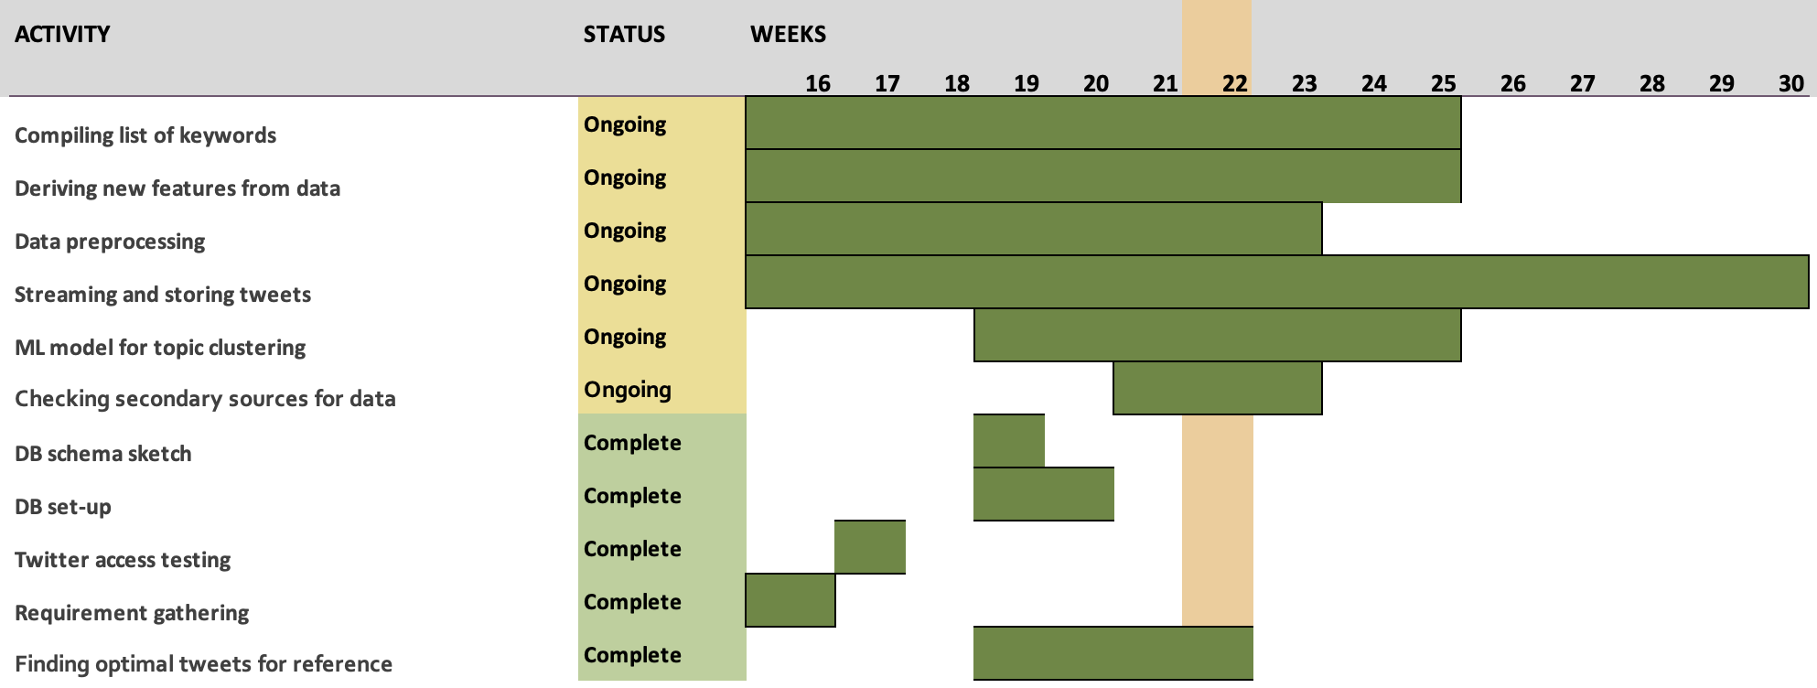
Optional: Roadmap/Progress Chart

