Slide 1
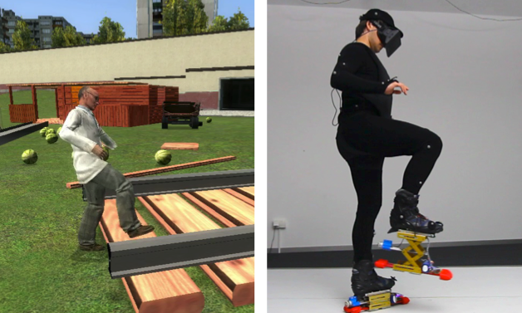
Level-Ups Motorized Stilts that Simulate Stair Steps in Virtual Reality
dominik schmidt, robert kovacs, vikram mehta,
udayan umapathi, sven köhler, lung-pan cheng, patrick baudisch

Slide 2
Notes:
levelUps are telescopic shoes, which you can wear in virtual environment in combination with head mounted displays.
And as you step on virtual objects they expand, giving you the sense of elevation.

Slide 3
introduction
Notes:
Why are we doing this?

Slide 4
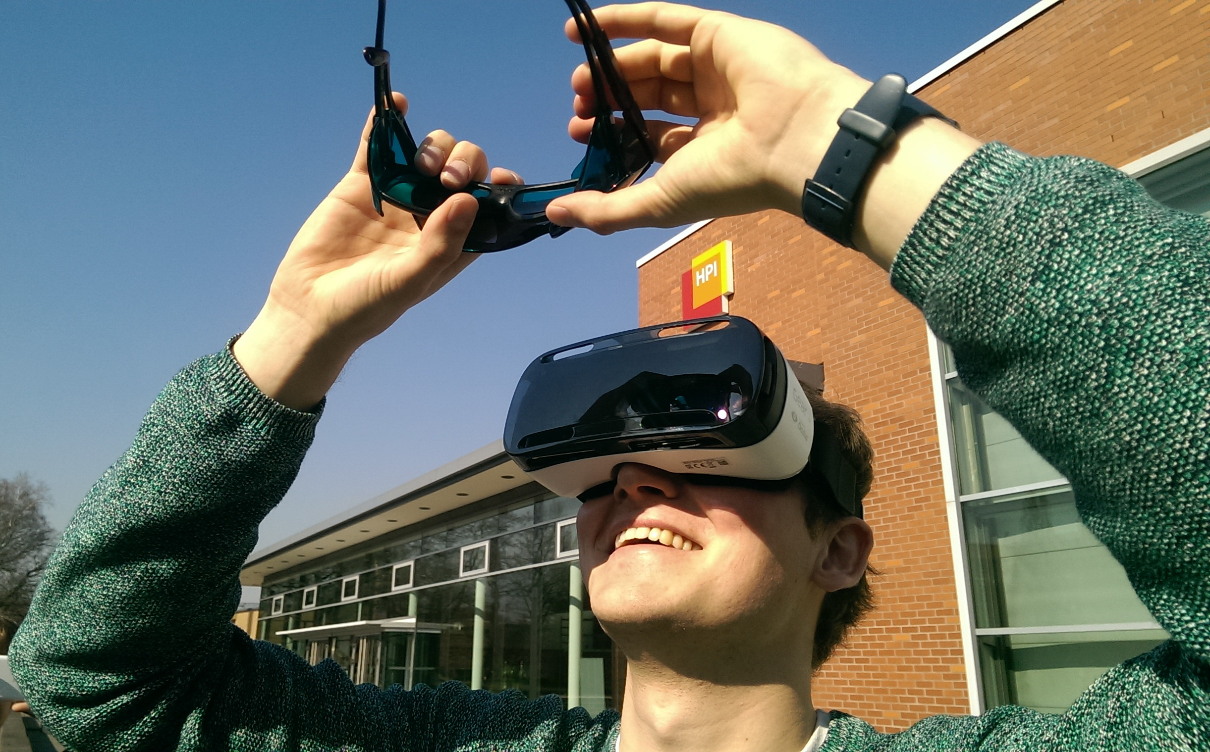
(visual) VR is obviously happening right now
Notes:
Obiviusly VR is happening right now, with lot of devices like occulus, gear and so on, but in VR research the question is for a while how can we improve this visual immersion giving more physical feedback.

Slide 5
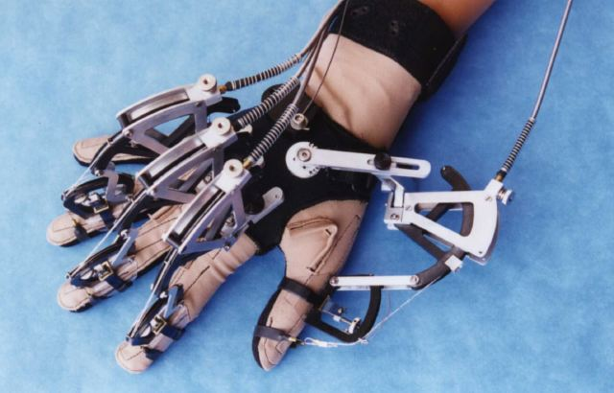
haptics
Notes:
So people had lot of ideas from haptic gloves to modeling virtual rooms…

Slide 6
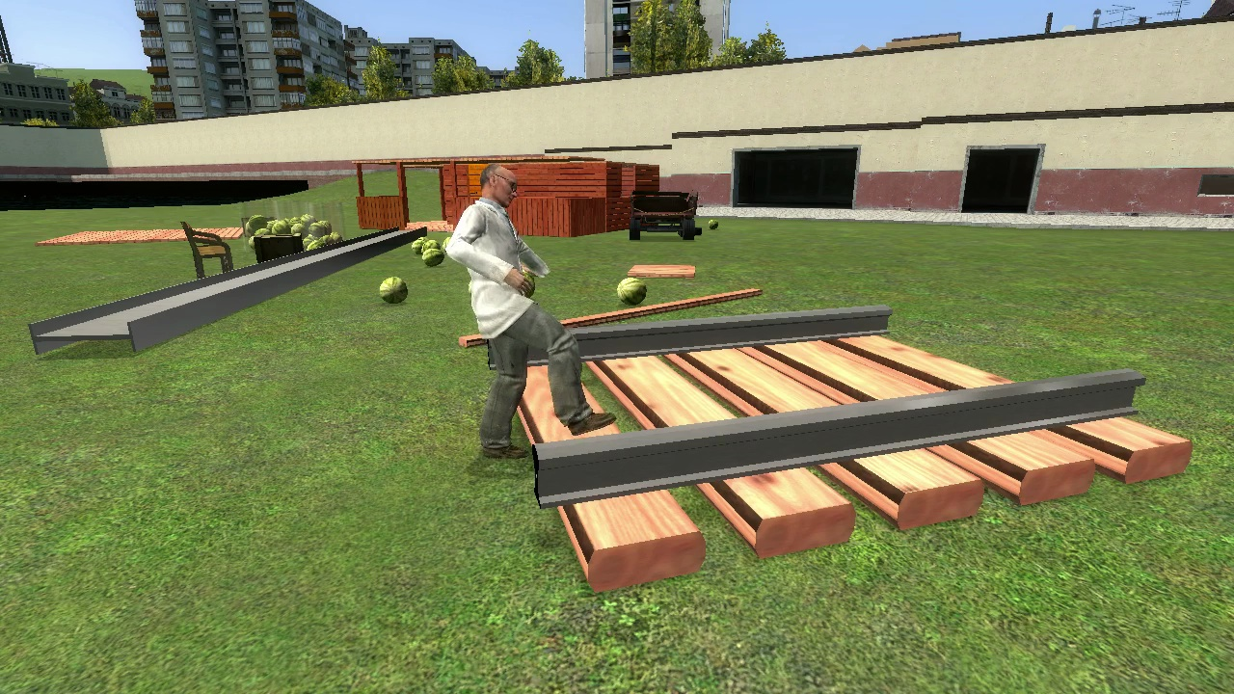
our focus: how to walk up/down steps in VR?
Notes:
But in this paper we focused on a very specific case, when we are steping on and off virtual objects.

Slide 7
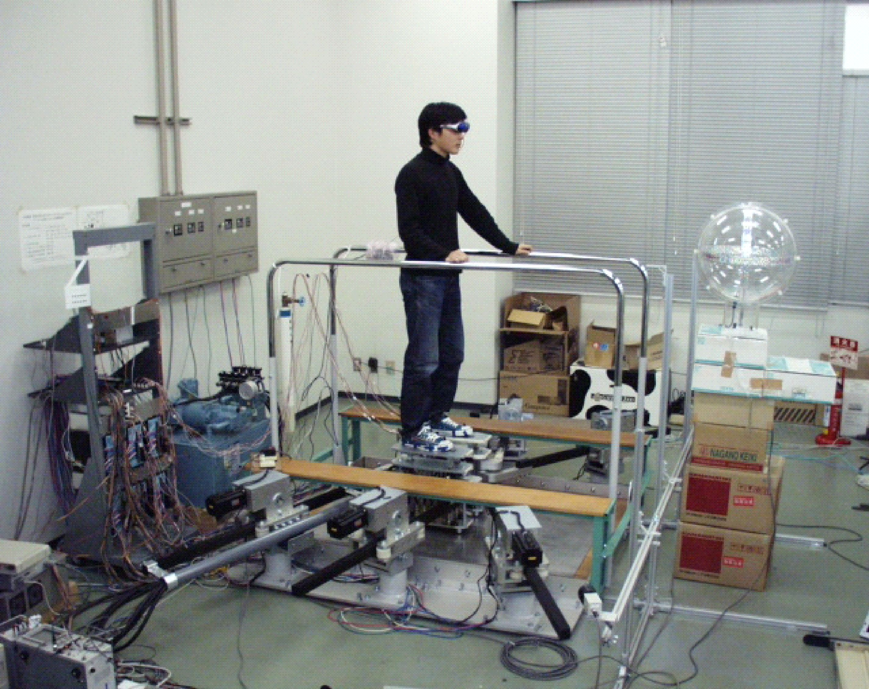
typically done with locomotion devices
ref
locomotion device
Notes:
Traditionally walk simulation has been solved with locomotion devices.
These are stationary devices which can give you the feeling that you are walking around, while you are actually stepping in one place.
So adding elevation to these devices is presumably straightforward.

Slide 8
how about „real walking“
Notes:
In the same time there is an other trend in virtual reality where people are debating that locomotion devices are not giving the full experience, we should allow people to walk around freely.

Slide 9
mobile platforms
[Iwata ‘04 CirculaFloor]
Notes:
So people tried around different combinations, for example this mobile devices that are moving with you and you can step on them consequently.
But we wanted to go a step further

Slide 10
Our goal:
elevation in real-walking environments, wearable
Notes:
To allow elevation in real-walking environments, with a wearable design

Slide 11
levelUps
Notes:
So here is what we made, this are the levelUps

Slide 12
Notes:
This is the video what I have already shown, where the user is stepping on virtual objects

Slide 13
Notes:
The main mechanism is this golden component, called lift table or scissor table.
And we also added a couple more components, the actuation, the sensing system, but I’ll walk you through all of these in a minute.

Slide 14
Notes:
Here is just an other scene

Slide 15
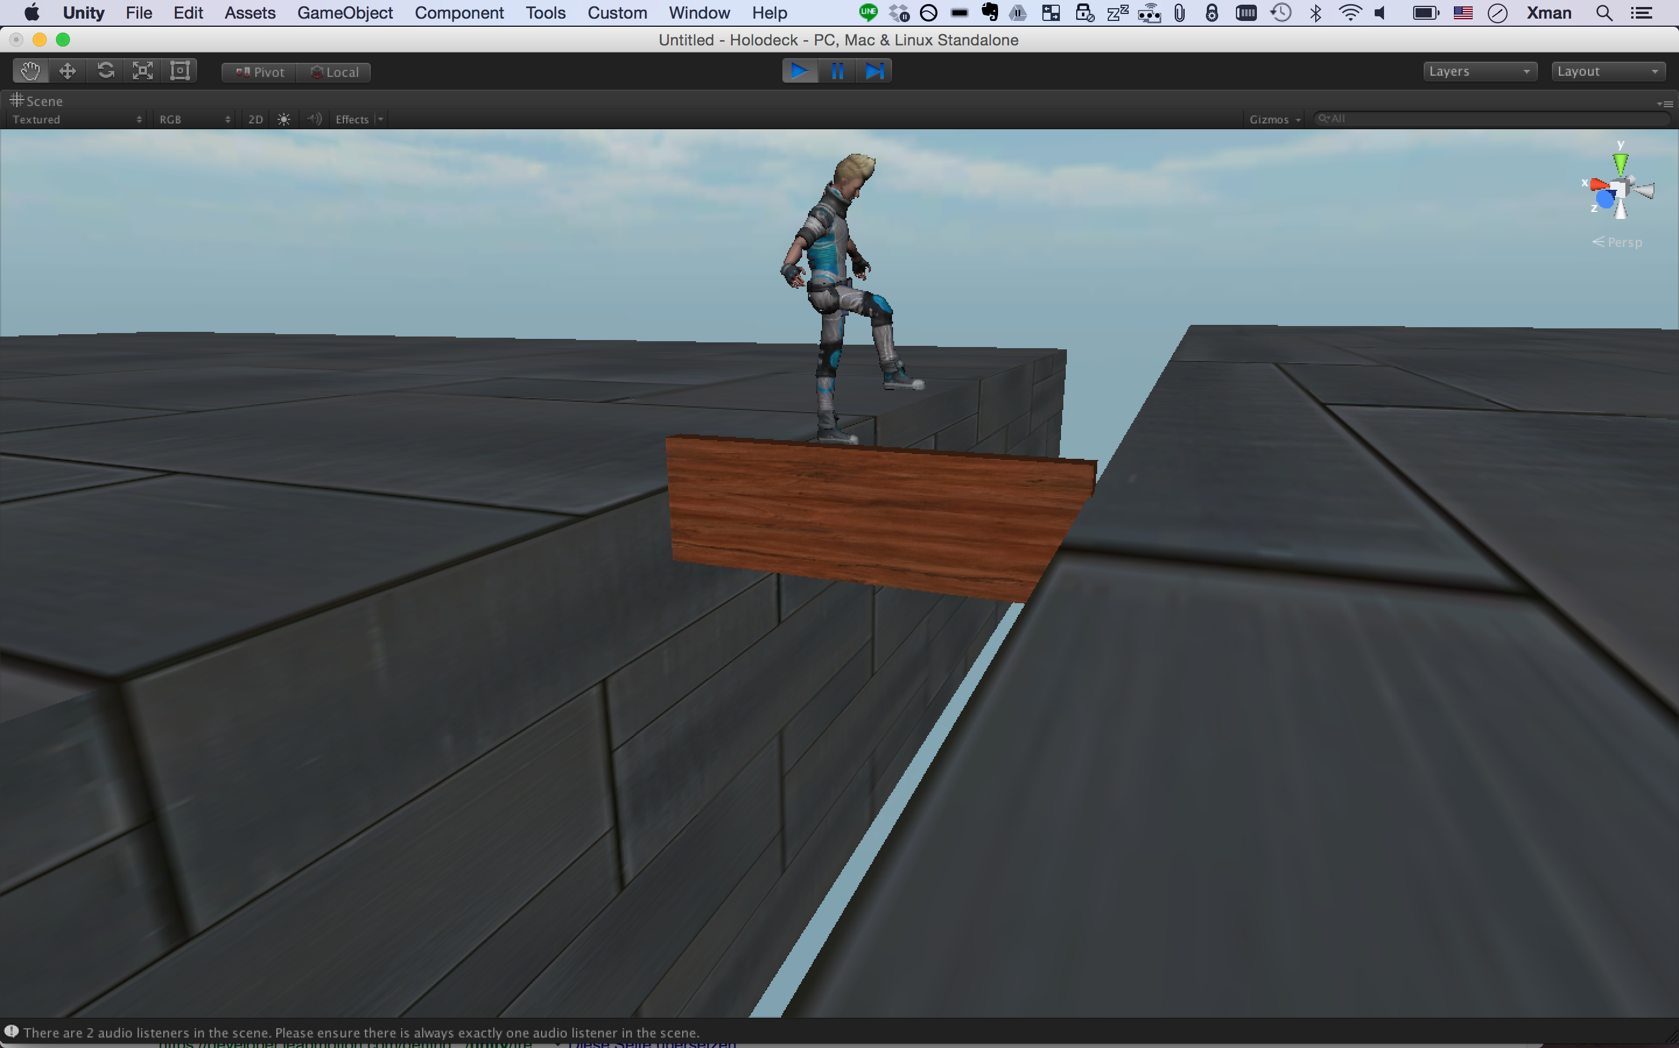
simulating depth
Notes:
Primarily LevelUps are designed to simulate elevation, but there is an other scenario where you could use them for simulating depth.
For example while you are balancing on a beam they are fully extracted and when you would put your feet left and right they would retract, giving you the feeling of a void.

Slide 16
Main contribution
elevation in real-walking environments
wearable
wireless
Notes:
But on the whole the main contribution is that level ups can simulate elevation in real walking environments, while the device itself is wearable and wireless.

Slide 17
mechanical design
Notes:
Now let me tell you about the mechanical design.

Slide 18
presumably, the hardware design was simple and straightforward…
Notes:
presumably, the hardware design was simple and straightforward…

Slide 19
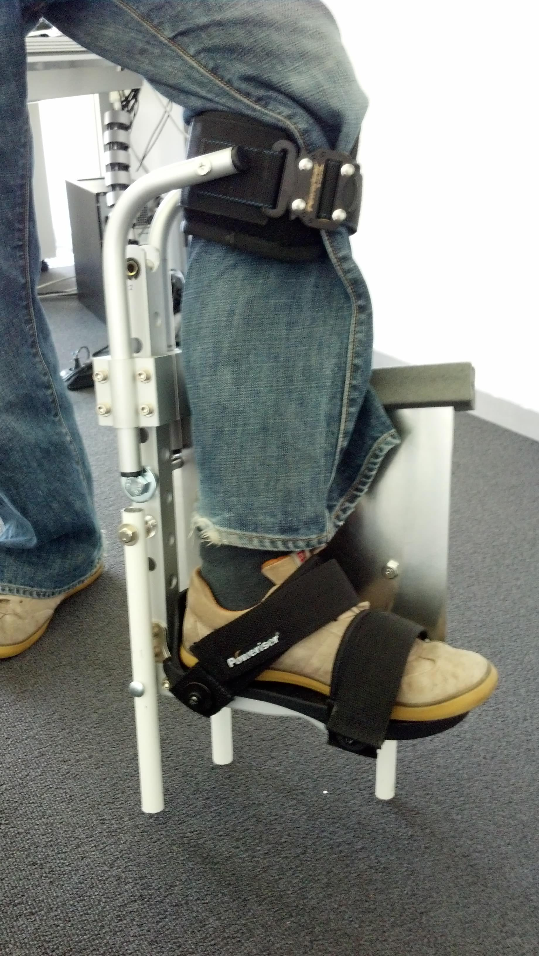
Notes:
Except from that it was not…

Slide 20
Notes:
We tried lots of other designs, as you can see

Slide 21
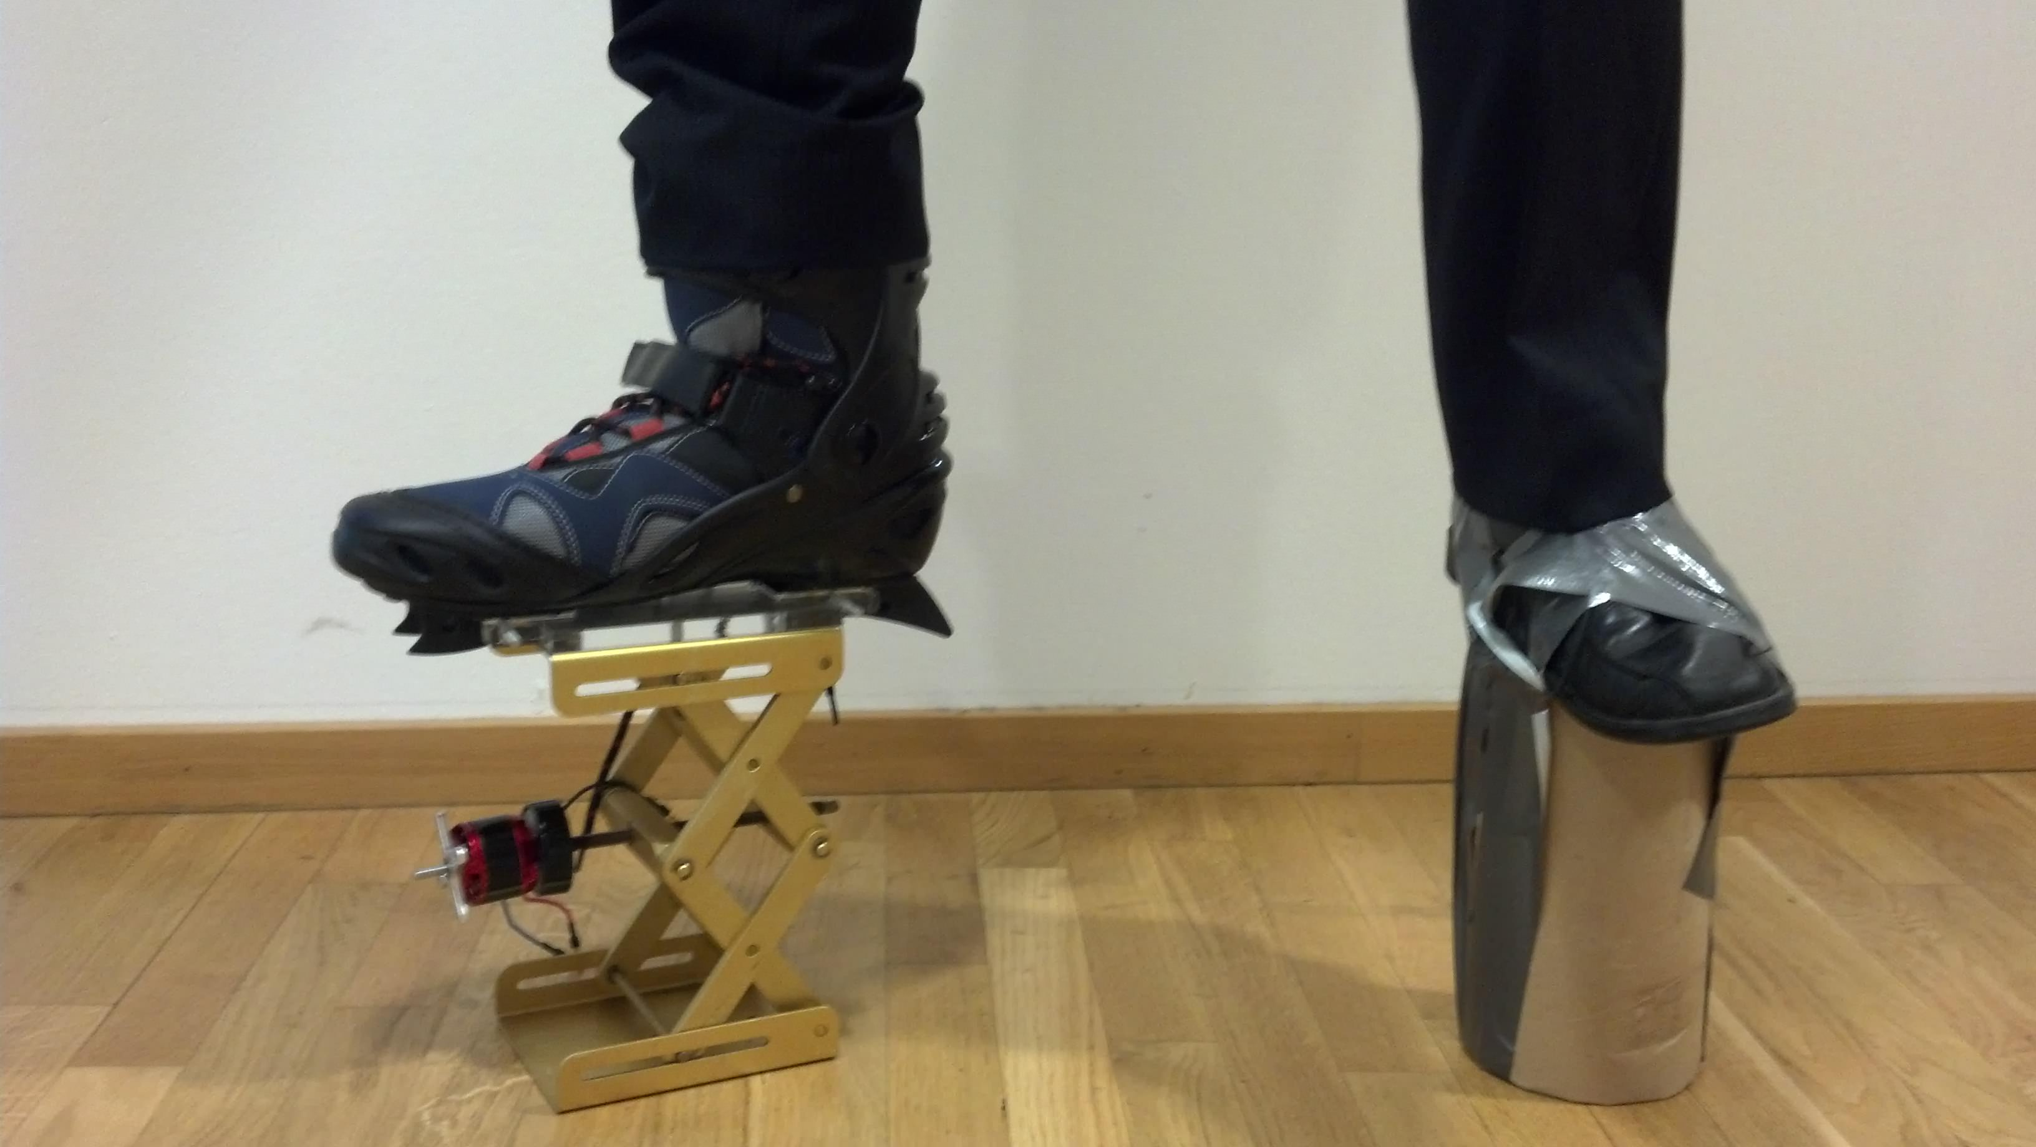
Notes:
And made lots of prototypes.

Slide 22
#1 vertical actuation
Notes:
But let me just walk you through our final solution.

Slide 23
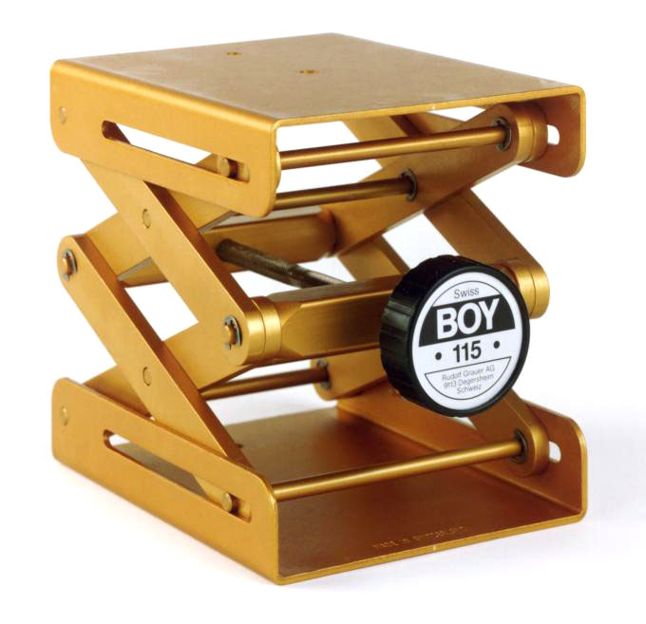
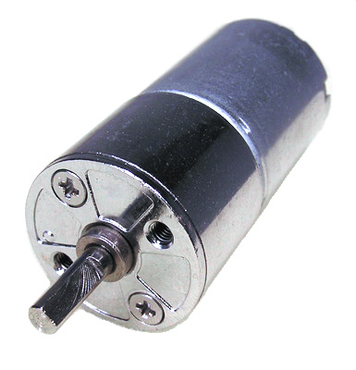
+
challenge:
Notes:
The primary component is the lift table, what is originally designed for manual actuation with the knob.
So we needed to motorize it.

Slide 24
Notes:
The key challenge here was this blue carriage, which allows the motor to move together back and forth with the actuation thread, and in the same time holds the motor fixed

Slide 25
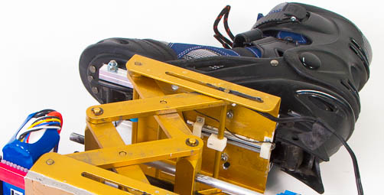
measuring the height with
a potentiometer
Notes:
And to give the electronics the sense how high the boot is right now, we added a linear potentiometer which actually measures the height of the lift table

Slide 26
#2 control
Notes:
But there is a little bit of more control…

Slide 27
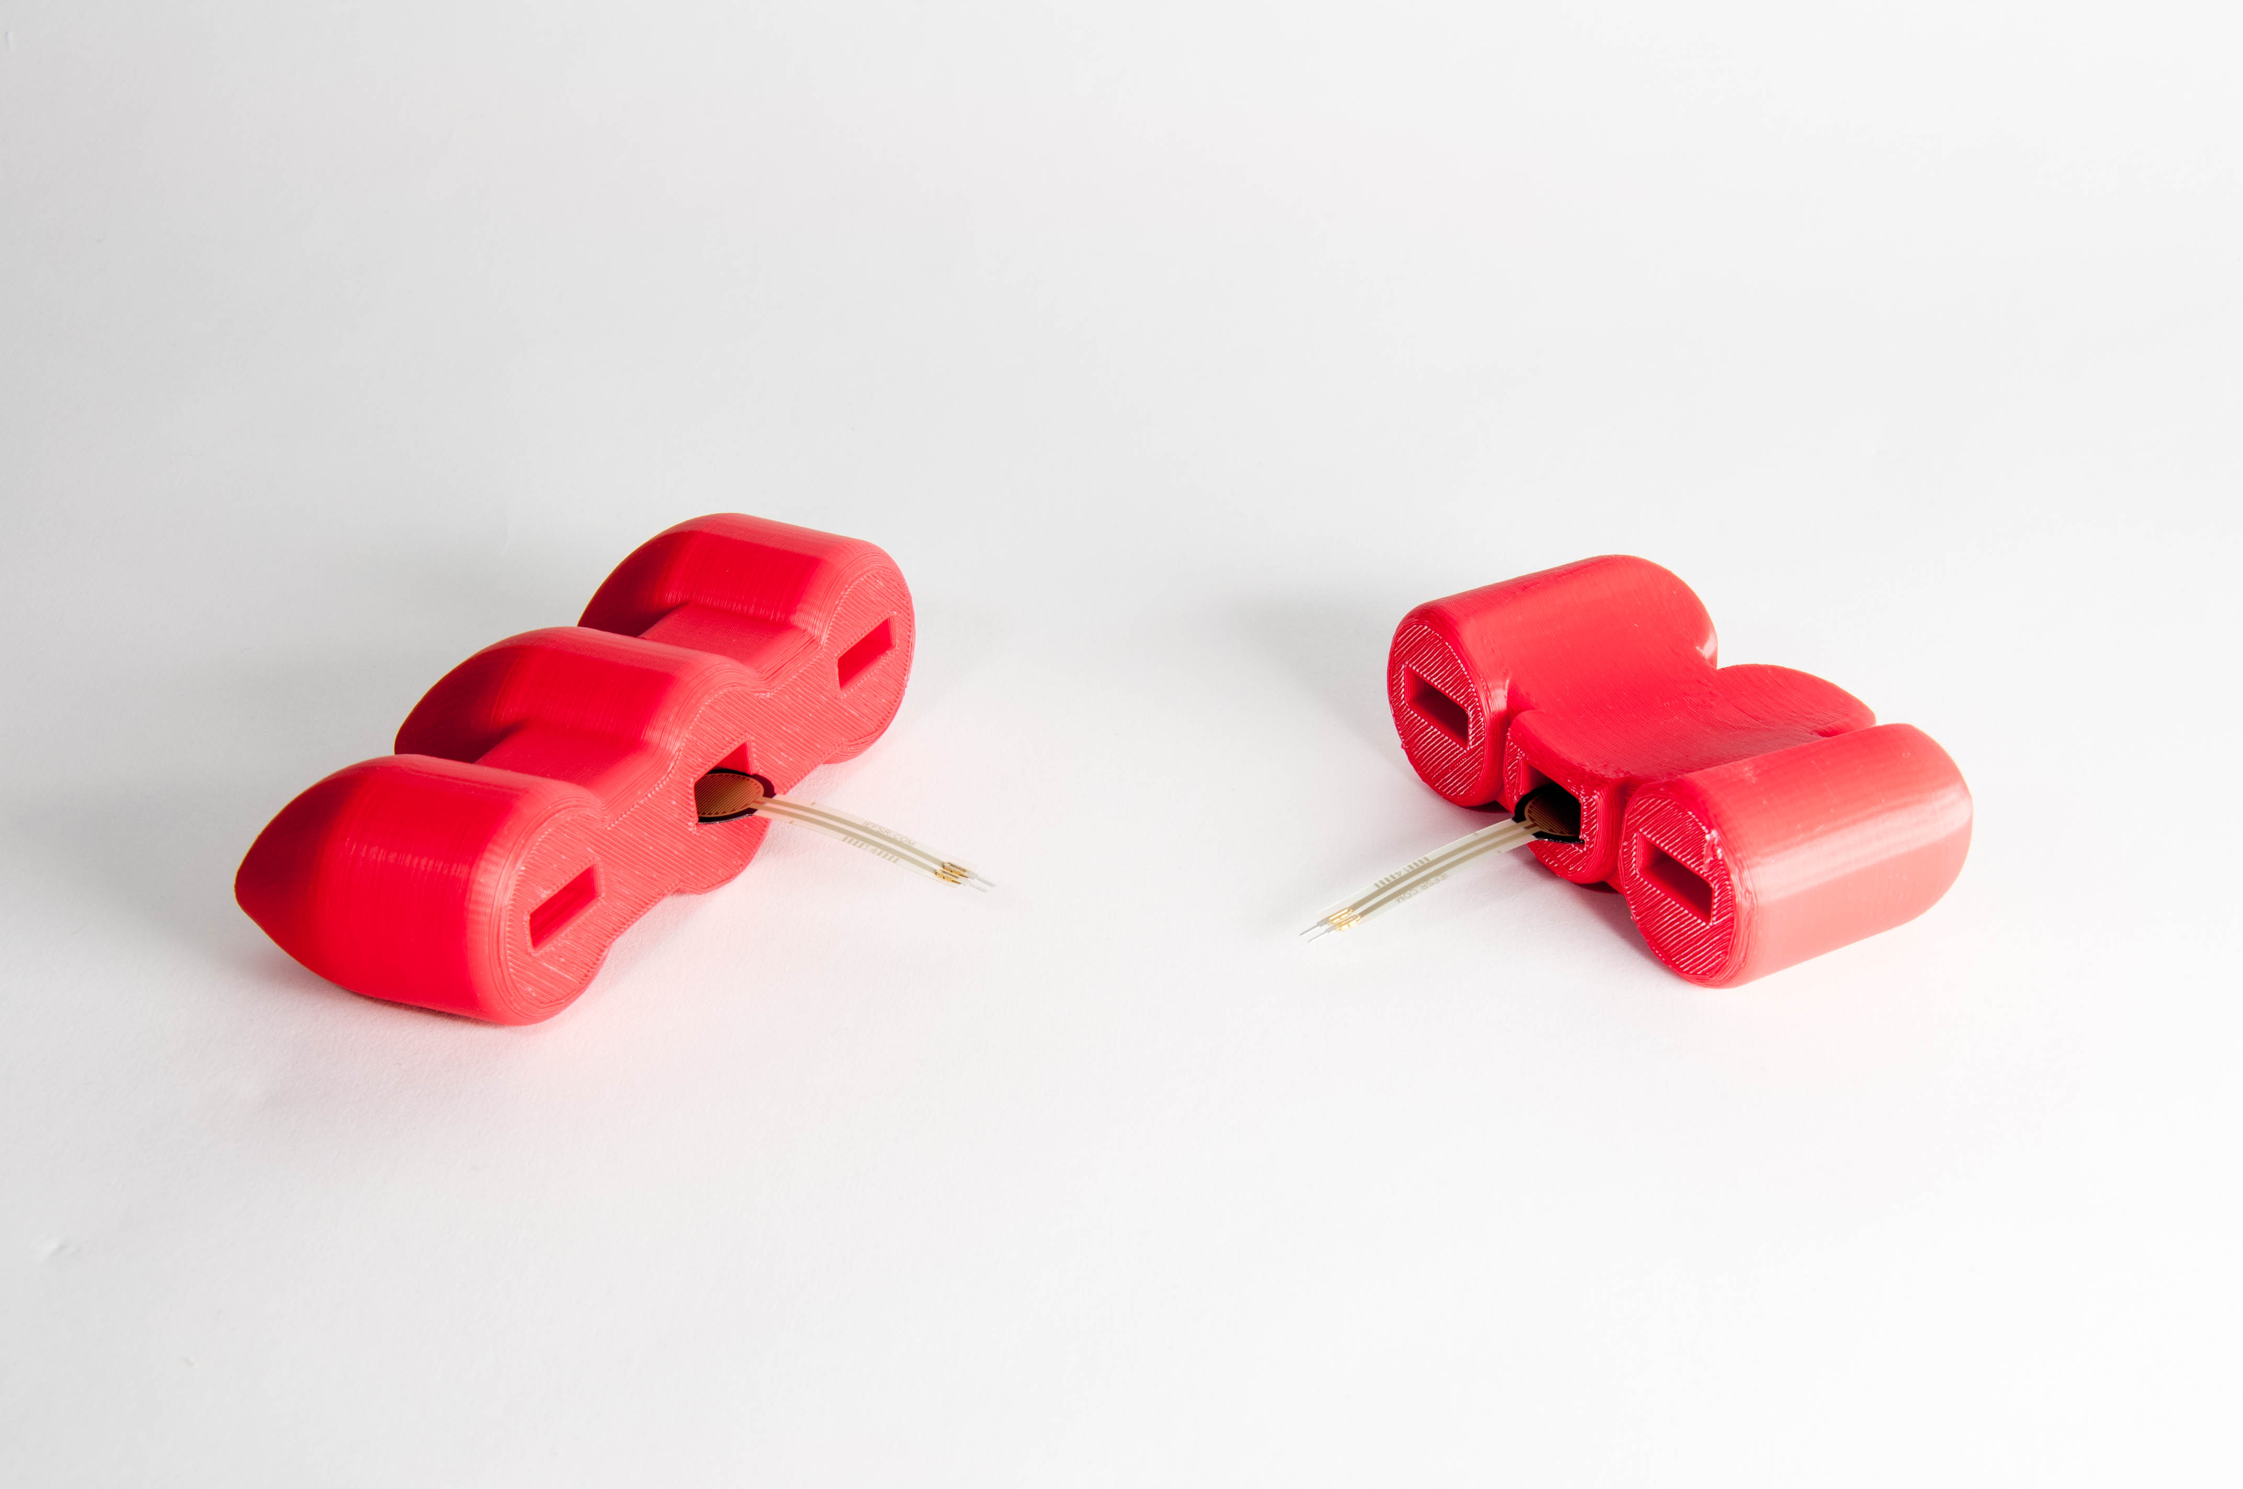
pressure sensor
Notes:
there are pressure sensors integrated into the toes and heels.
Let me tell you why.

Slide 28
Lifting a person → even bigger mechanics, heavy device
→ we drive the mechanism when the foot is in the air, light device
→ That’s what the pressure sensors do
Notes:
Our original idea was to create a design what could actually lift a person, but it turned out that this would require lot of power and heavy mechanism.

Slide 29
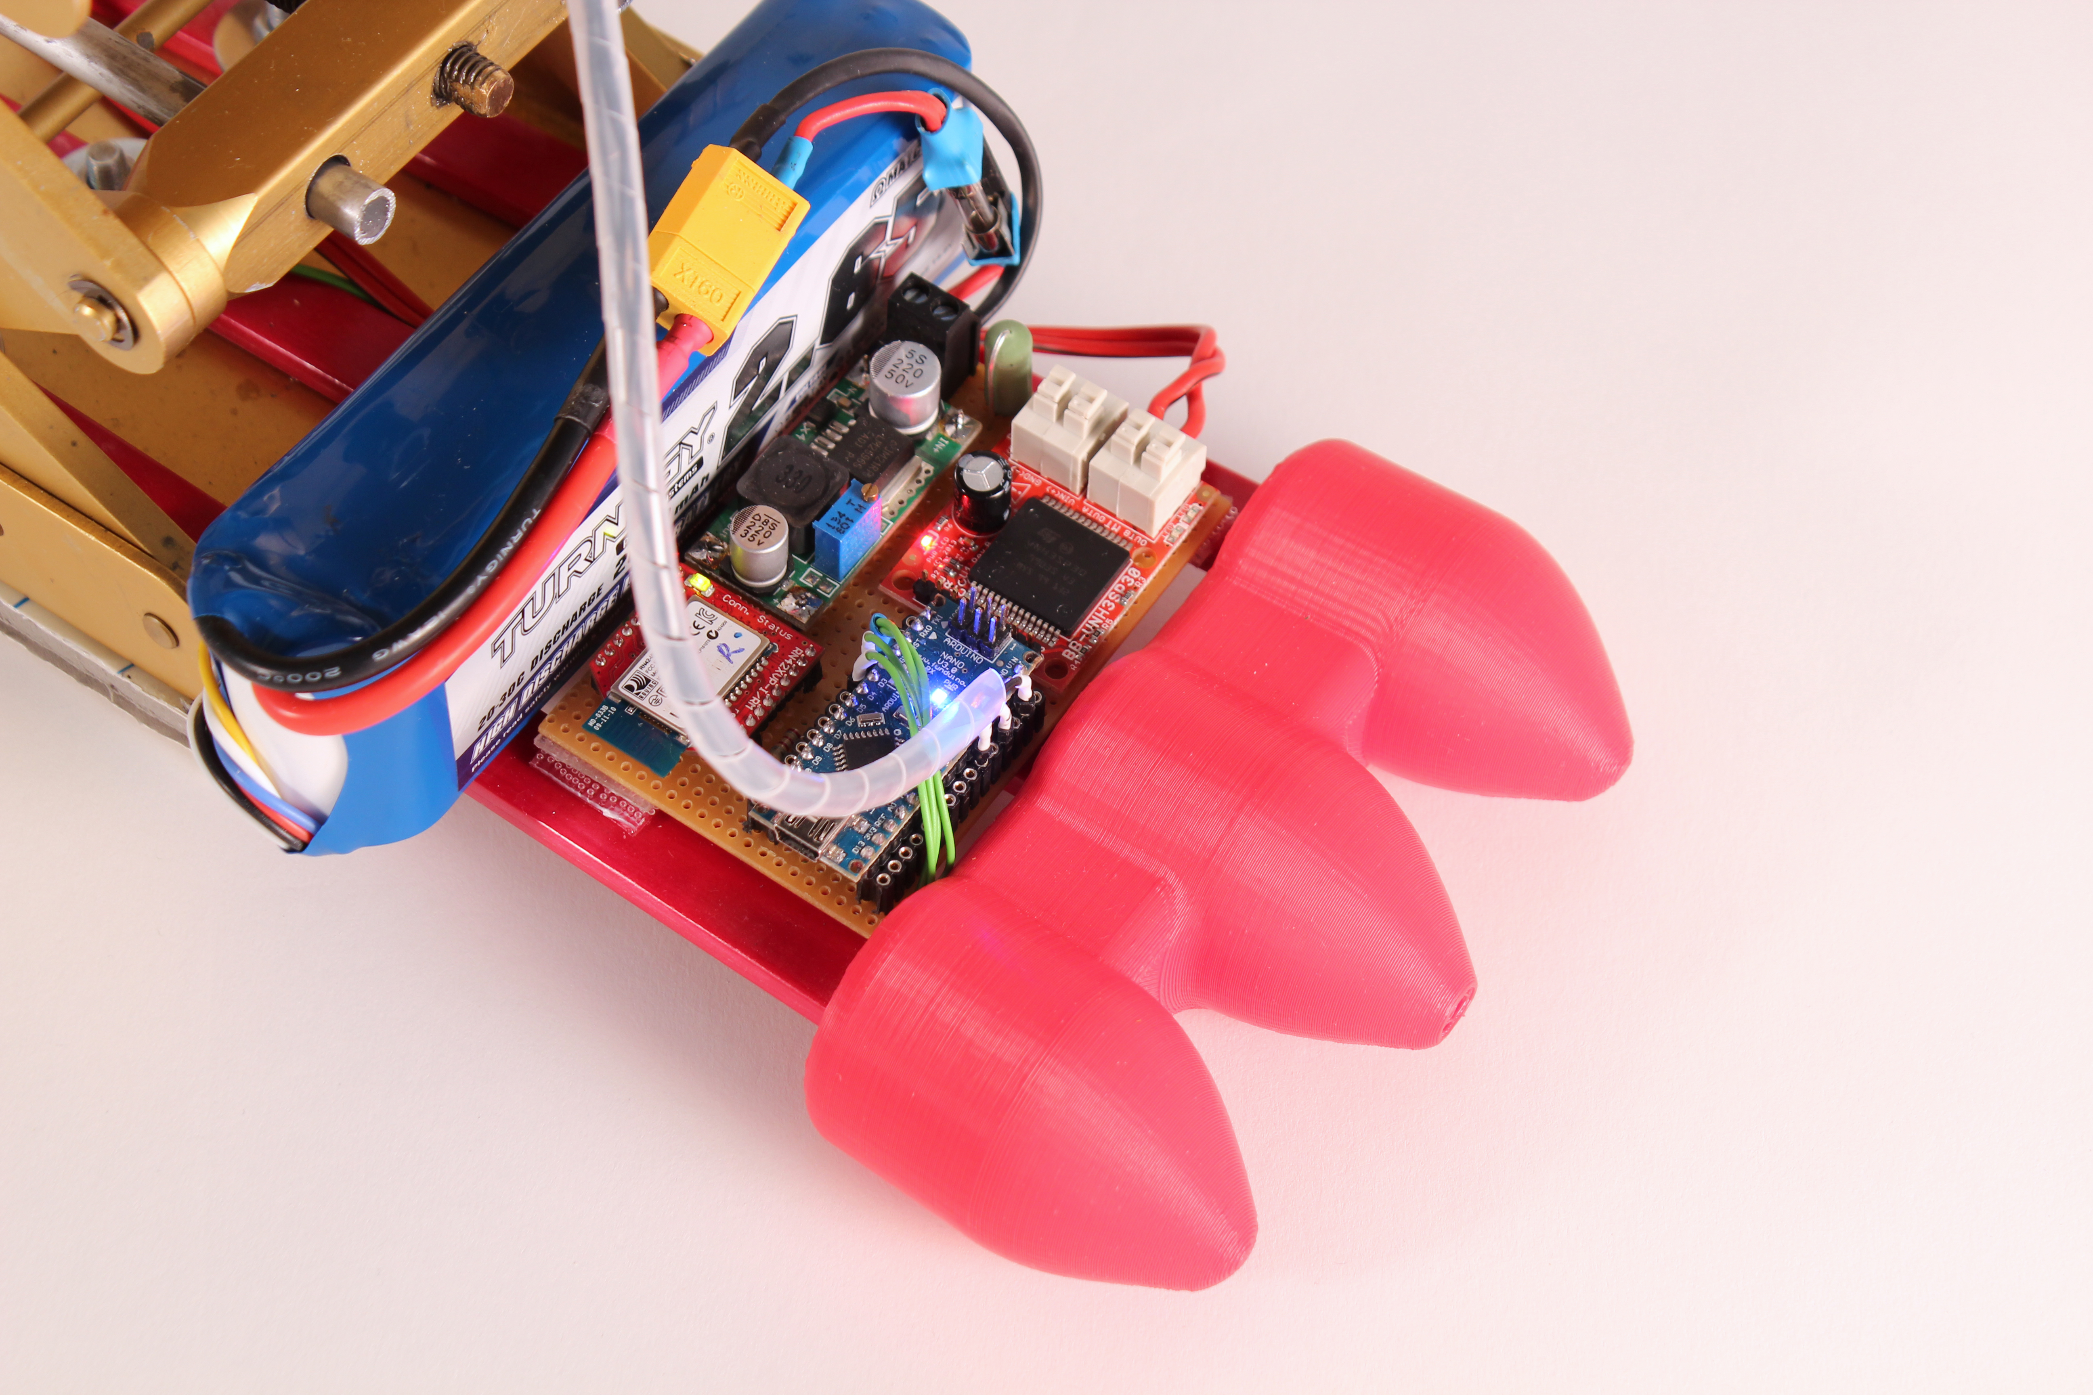
pressure sensor
Arduino nano
Notes:
This sensors are connected to an Arduino nano, which also drives the motor system and does the logic.

Slide 30
#3 artifical foot
Notes:
We also had to designed an artificial foot…

Slide 31
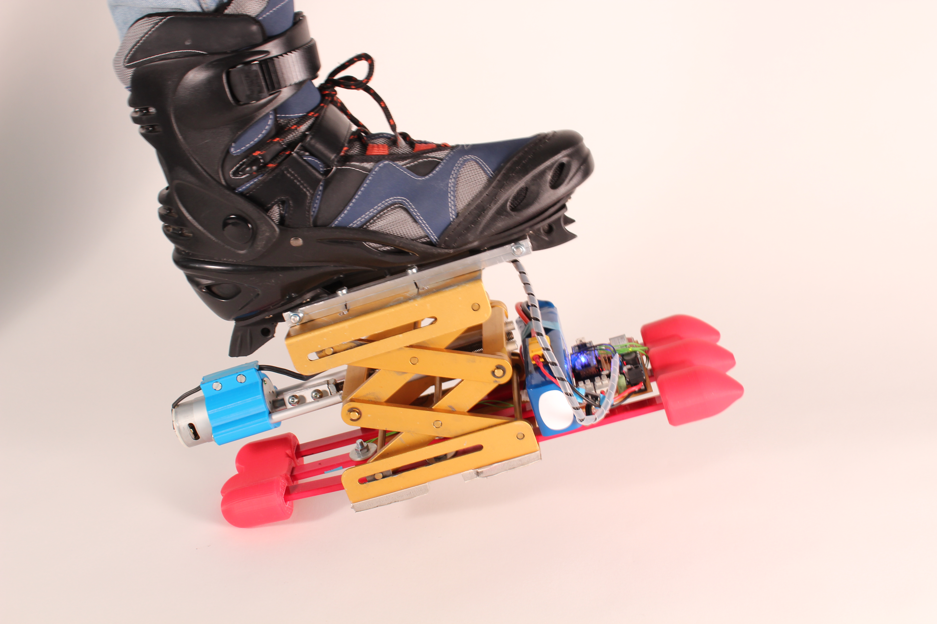
flexibility
Notes:
Because our initial design was completely rigid and it doesn’t felt very well.
So we decided to add a little bit of flexibility with these fiberglass red sticks on the bottom.

Slide 32
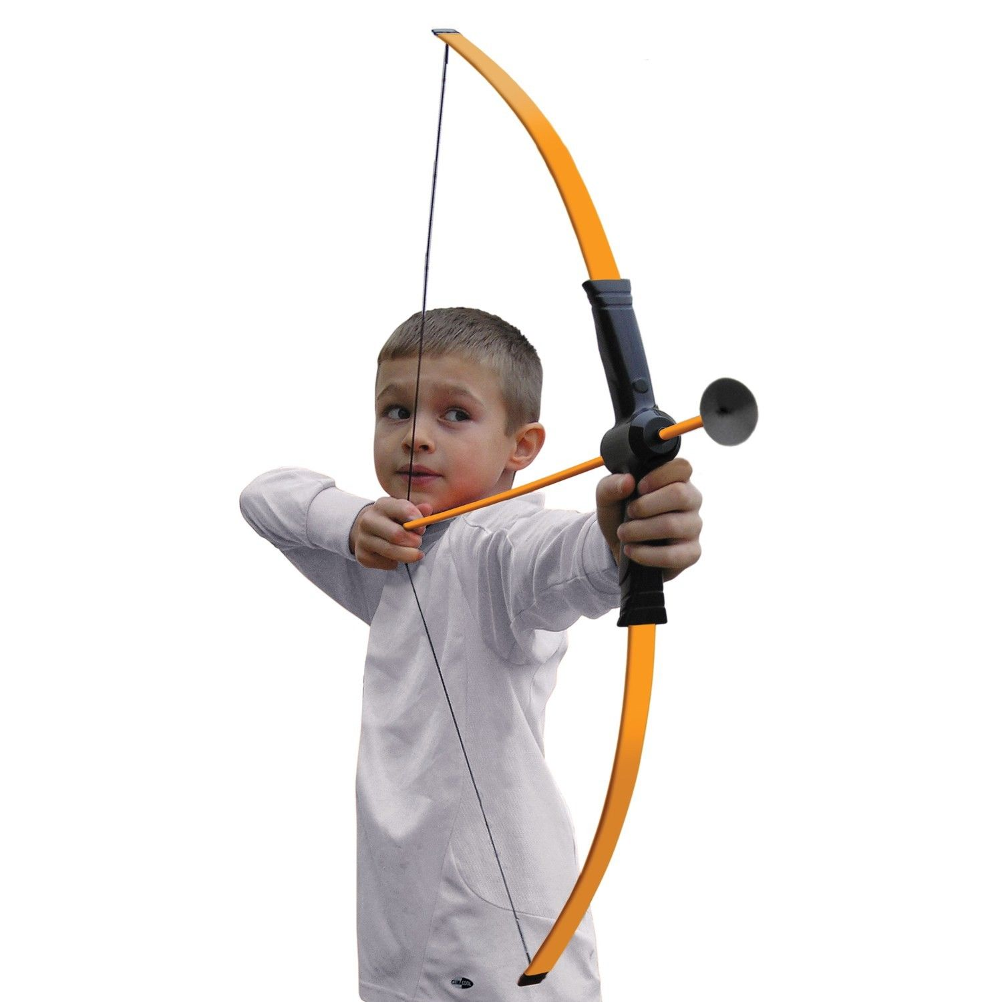
we used fiber glass
Notes:
Which we actually get from a kid bow.

Slide 33
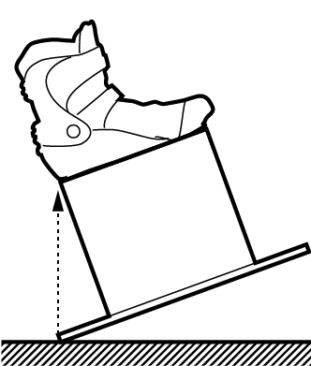
preserve the impact angle → increased length of the sole

Slide 34
#4 ankle
Notes:
Ok, next problem was stabilizing the ankle.

Slide 35
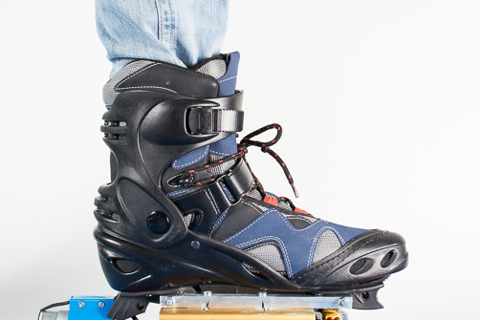
support the ankle
Notes:
The human ankle is actually designed for working reasonably close to the ground., but since we operate it them now on 30 cm heigh, we needed to add support the ankle.
Initially we tried to completely immobilize the foot, what is not a good experience.
Than we realized that what we really need to do is to prevent the left right movement, and to allow to flexing back and forth.

Slide 36
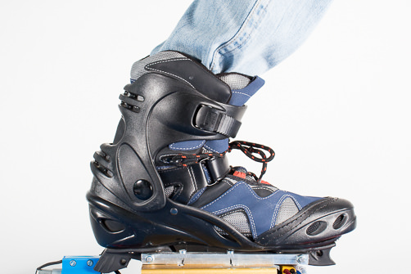
Notes:
And that is exactly what the regular roller-skate boots does.
As you can see..

Slide 39
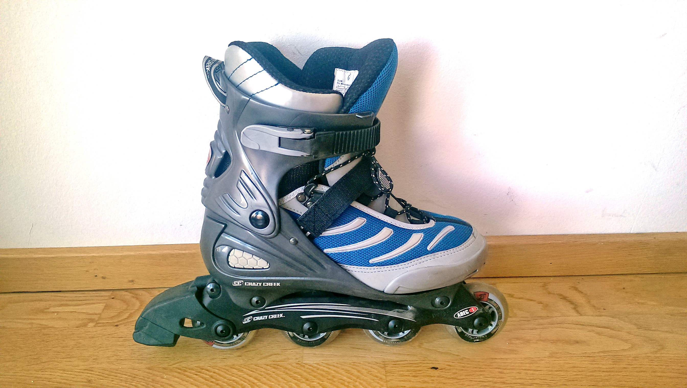
Notes:
We used a boot from a normal rollerblade skate.

Slide 40
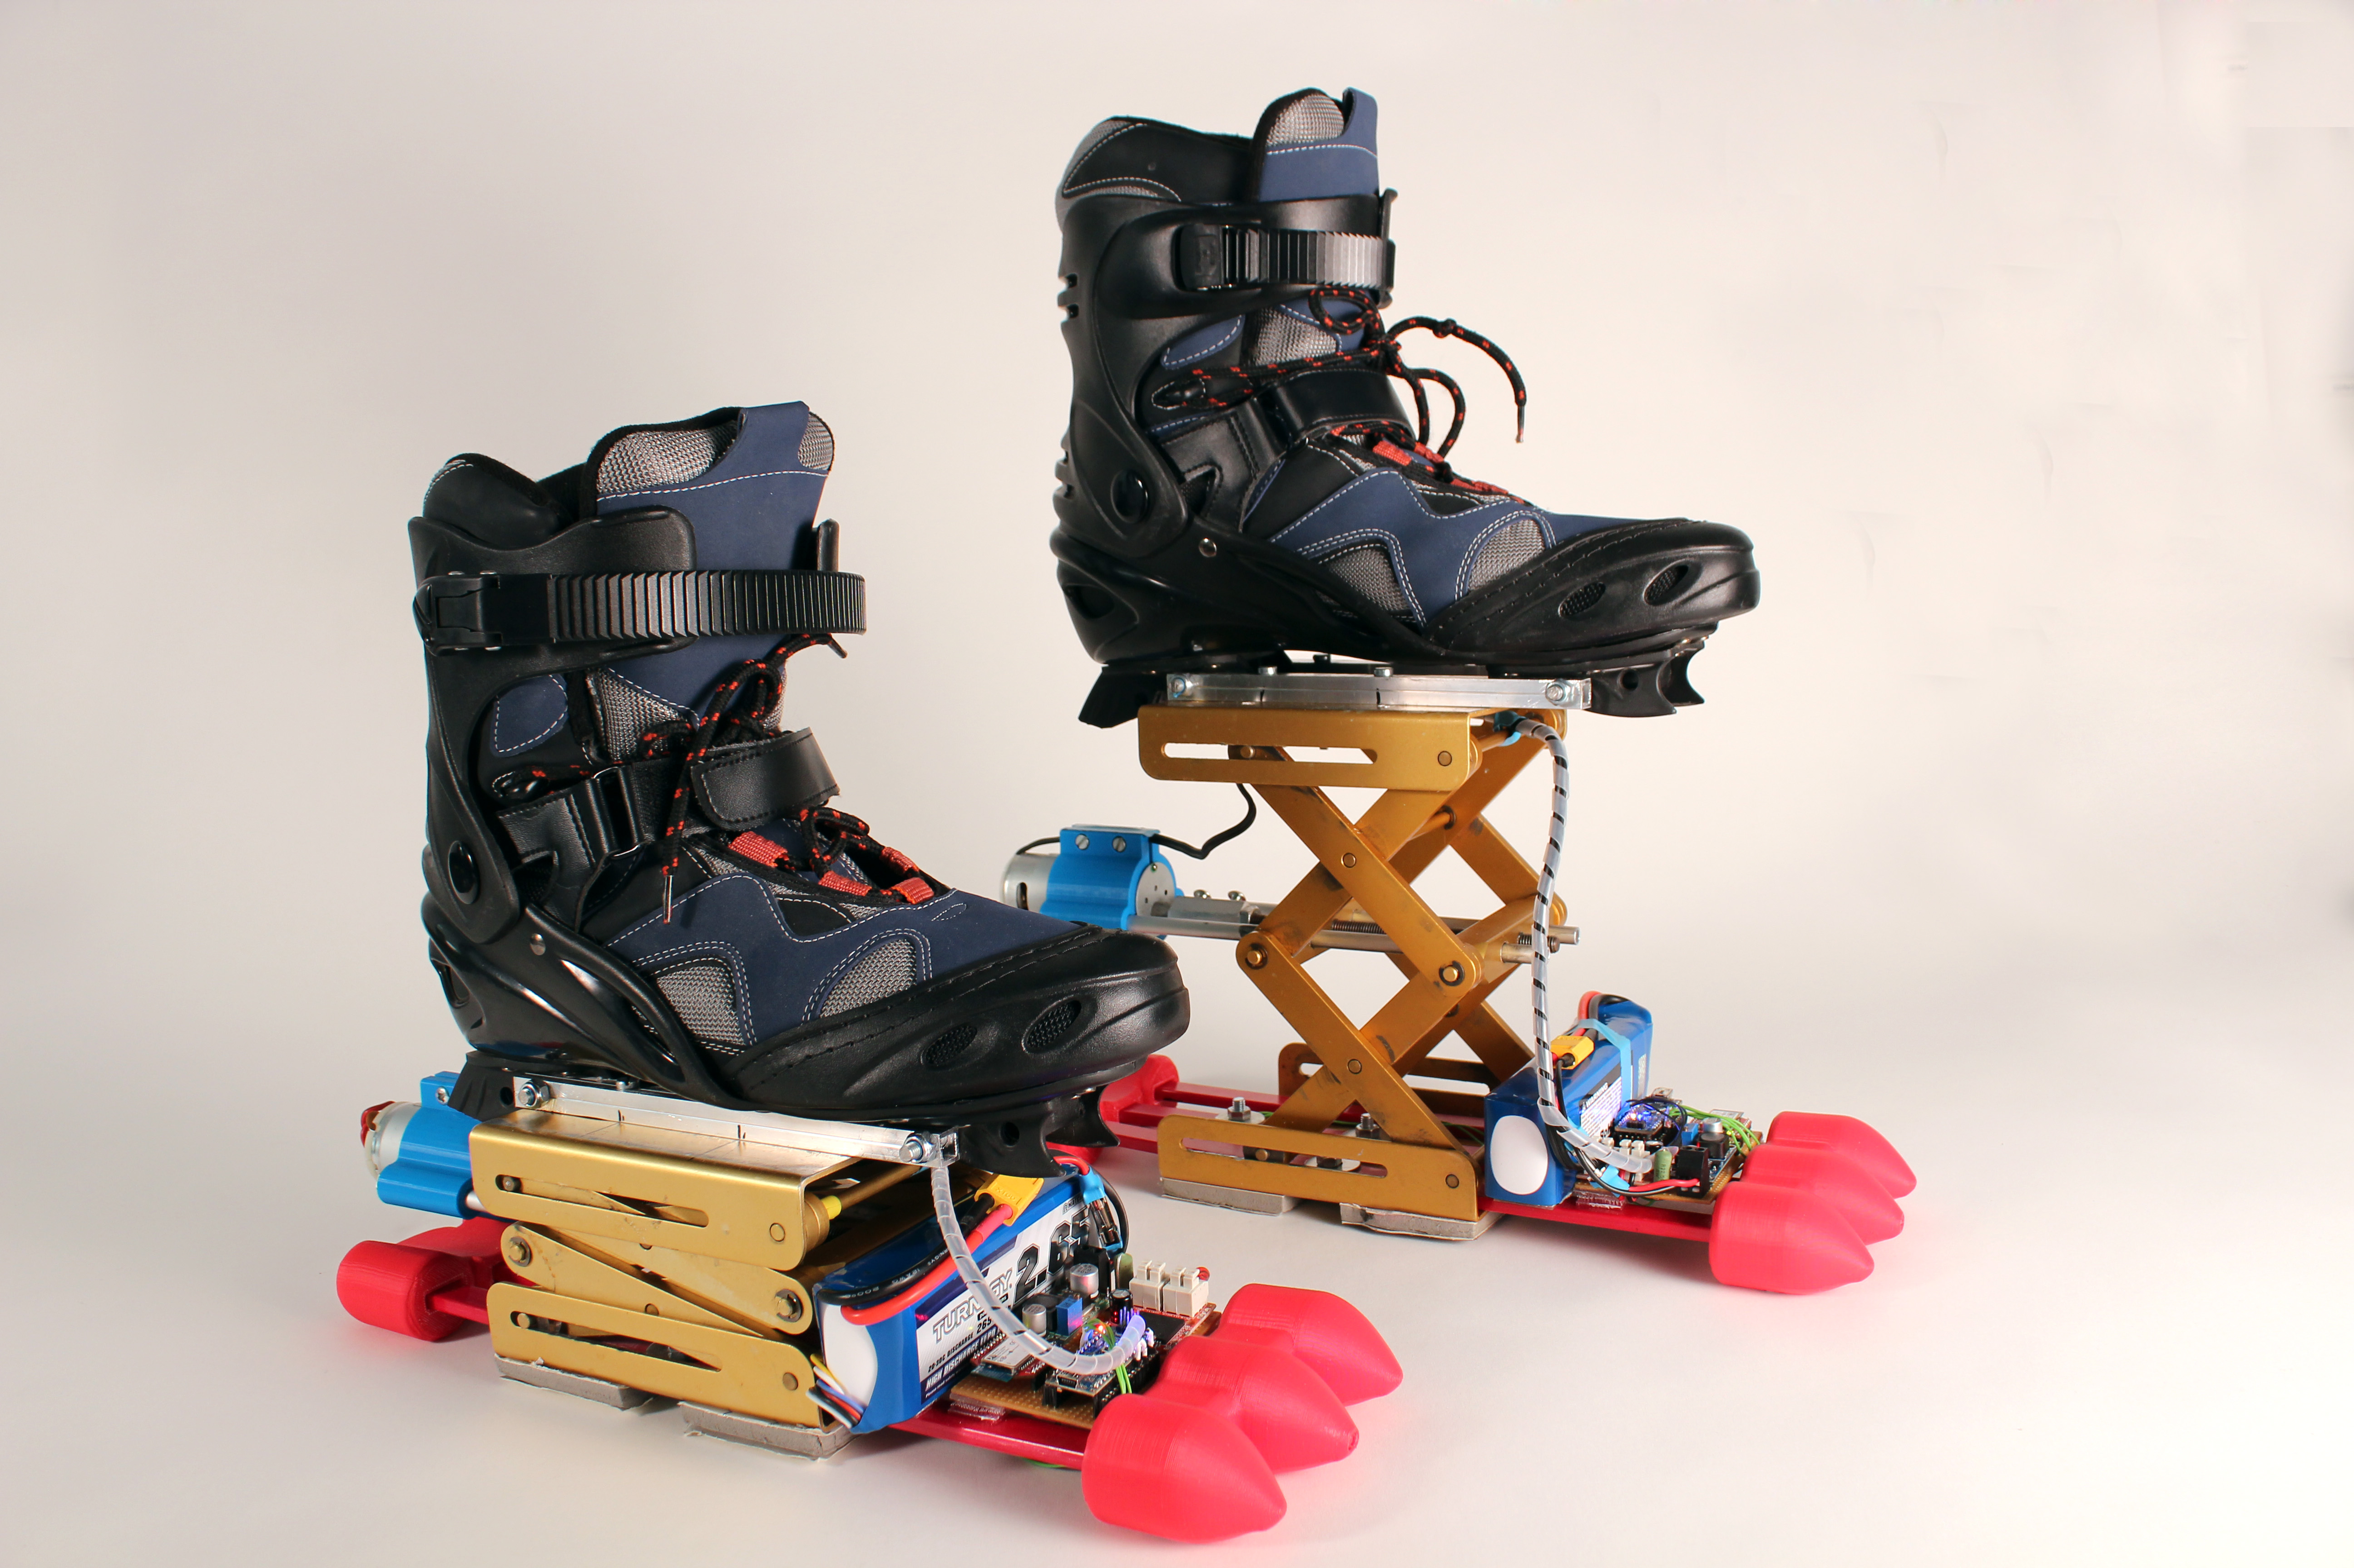
Notes:
So this is our final design.

Slide 41
#5 system
Notes:
They are operated in a typical VR environment.

Slide 42
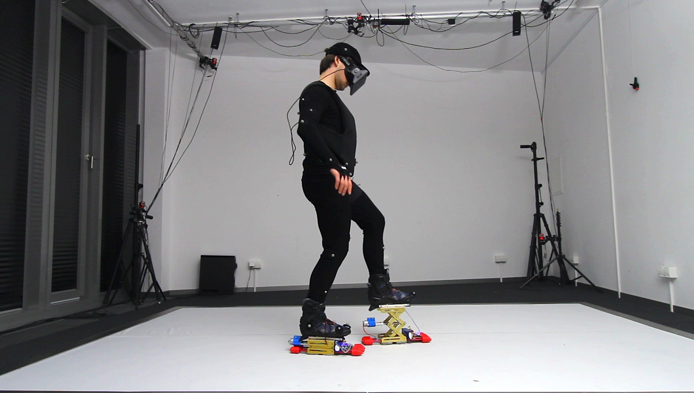
Occulus Rift
MacBook
Notes:
Here Sven is wearing the Oculus and a MacBook on his chest, where the actual VR processing is running.
As you san see everything is wireless, the stilts are controlled via Bluetooth.

Slide 43
motion capture suit
motion capture cameras
Notes:
To find out where the user is in the wirtual world, we used a motion capture system, in this case Optitrack.

Slide 44
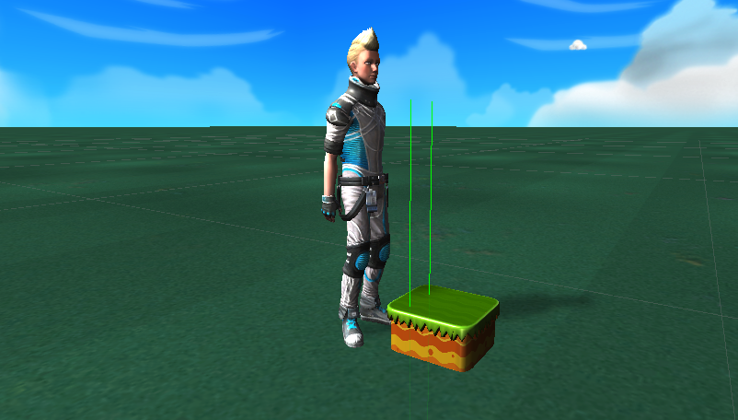
Unity3D; step prediction> do ray-casting from user position, then look for intersection with the ground
Notes:
The software system was implemented in Unity3D.
To give levelUps the chance to actuate in time, we did a simply ray-casting in front of the user, measuring the intersection with the ground, and sending the command to LevelUps for going up or down

Slide 45
evaluation
Notes:
Finally to find out if the stilts are good

Slide 46
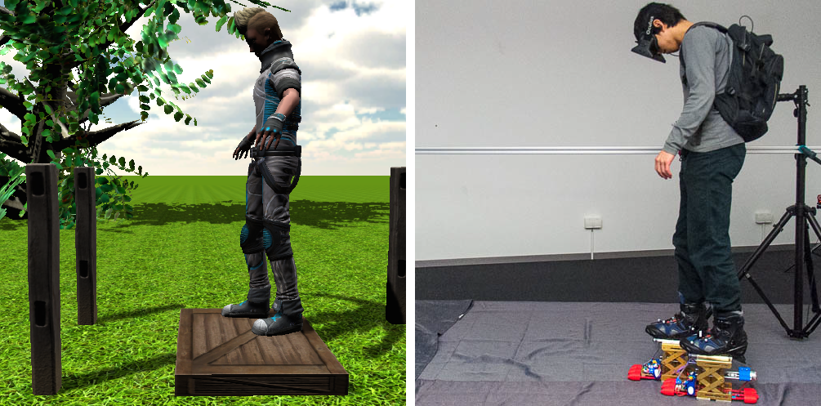
participants stepped on and off virtual boxes
Notes:
we conducted a brief evaluation in which participants stepped on and off virtual boxes

Slide 47
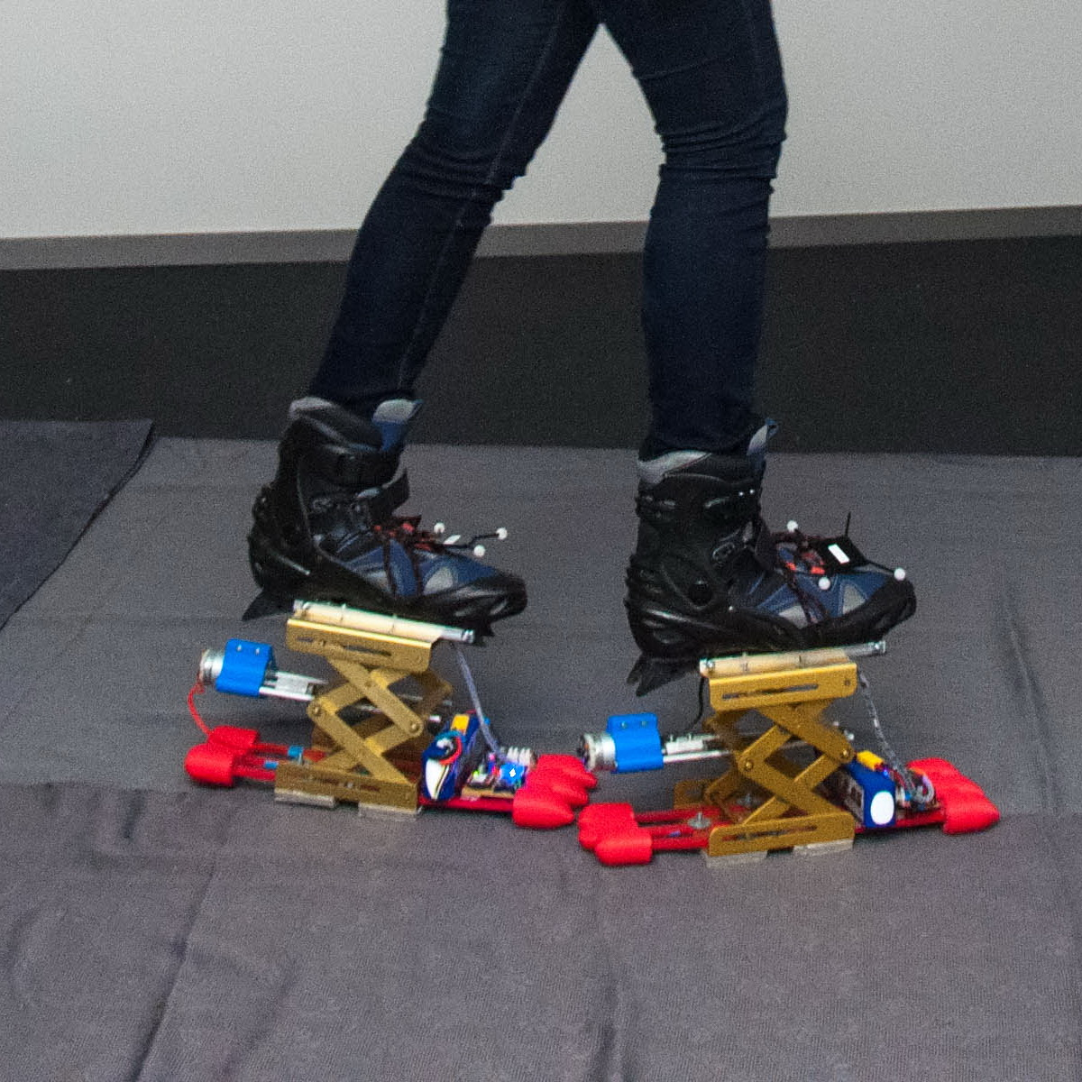
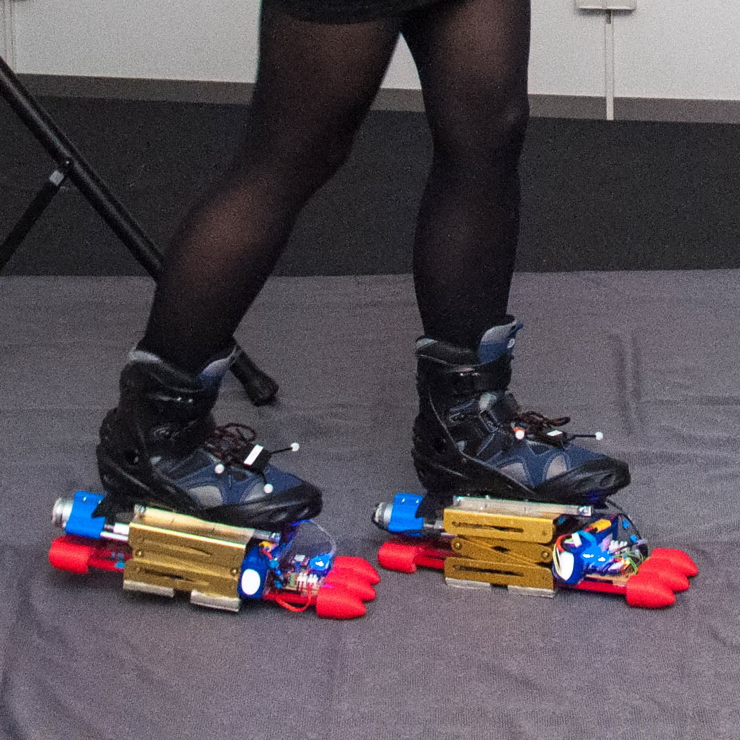
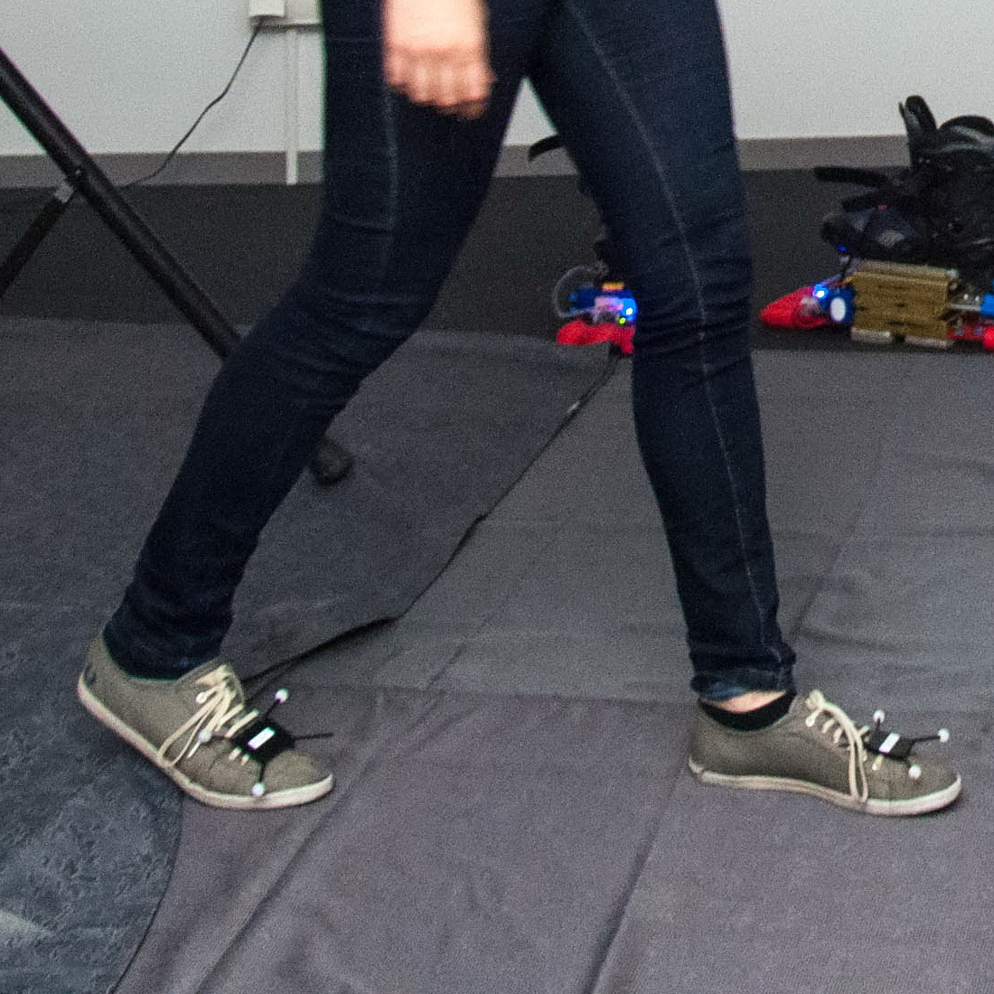
wear level-ups turned ON
wear level-ups turned Off
wear shoes
we tested three different conditions
Notes:
We tested three different conditions> the levelUps turned ON against two control condition, where the levelUps were turned off and last, where the user was wearing regular shoes

Slide 48
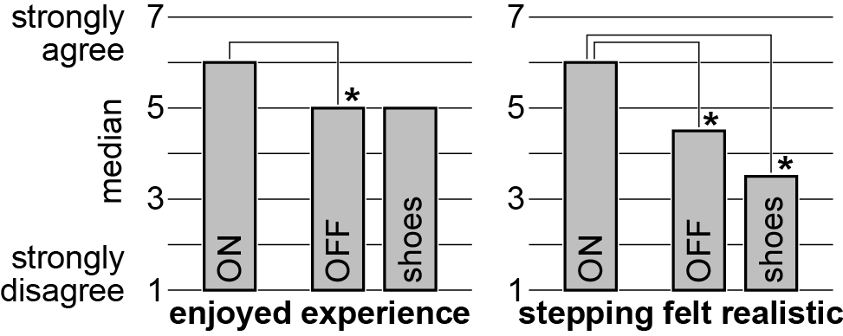
LevelUps ON
enjoyed the experience?
Notes:
As you can see participants enjoyed the experience when they were wearing the levelUps turned on

Slide 49
LevelUps ON
stepping felt realistic?
Notes:
And also judged as more realistic.

Slide 50
conclusion

Slide 51
Main contribution
elevation in real-walking environments
wearable
wireless
Notes:
So in conclusion, our main contribution was bringing the concept of elevation to real walking environments and we implemented it in a wearable wireless design.

Slide 52
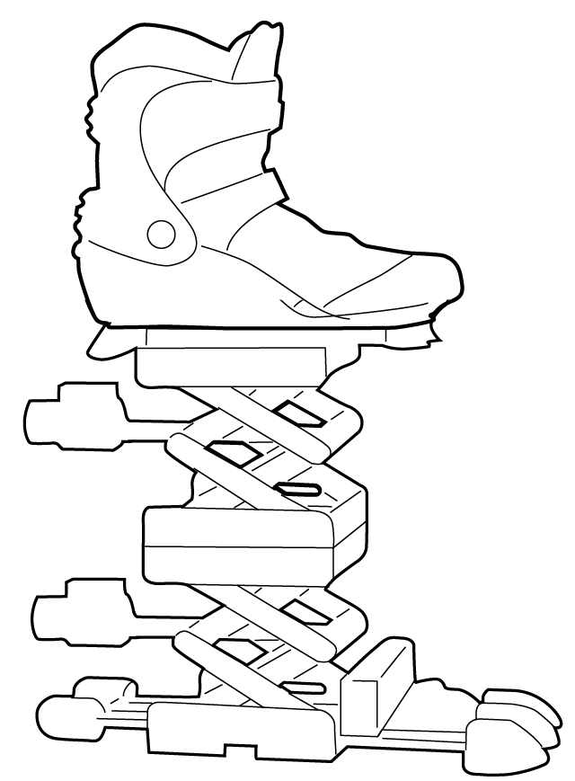
Next steps
Multiple steps at a time (right now need to re-arm in between)
Faster actuation, running?
Notes:
In the same time this device has also certain limitations, first of all it has limited length, so it can’t simulate multiple stare steps in a row.
But we can do is to slowly rewinding the device over time, and than it can be again actuated.
The second constrain is the speed of the actuation. Our LevelUps are good for walking, but certainly not for running.

Slide 53
Level-Ups Motorized Stilts that Simulate Stair Steps in Virtual Reality
dominik schmidt, robert kovacs, vikram mehta,
udayan umapathi, sven köhler, lung-pan cheng, patrick baudisch
Notes:
Thank you for you attention and I’m happy to take your questions.

